Slide 1
One-particle many-body Green’s function theory
Algebraic recursions, linked-diagram theorem, irreducible-diagram theorem, and general-order algorithms
So Hirata & Alexander E. Doran
University of Illinois at Urbana-Champaign
Peter J. Knowles
Cardiff University
J. Vincent Ortiz
Auburn University

Slide 2
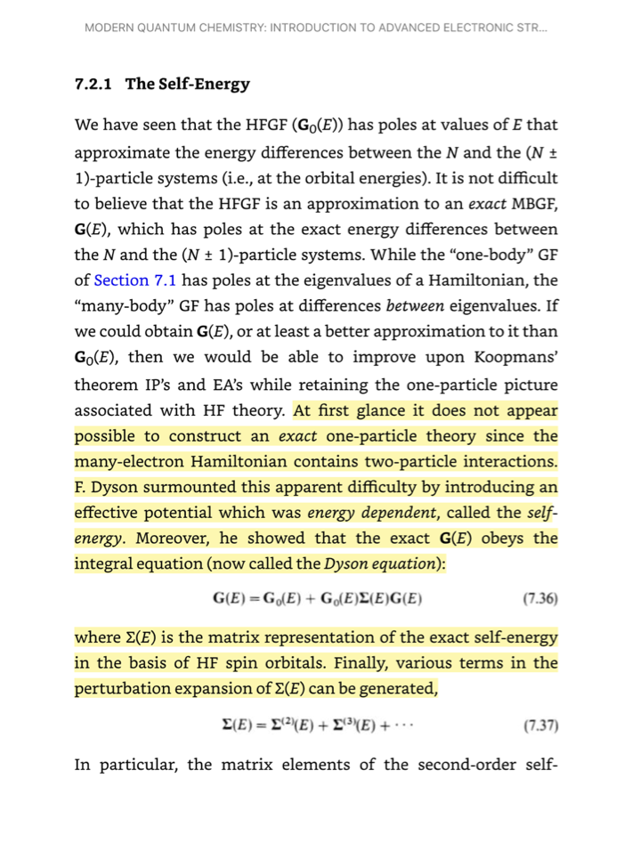

Szabo & Ostlund

Slide 3
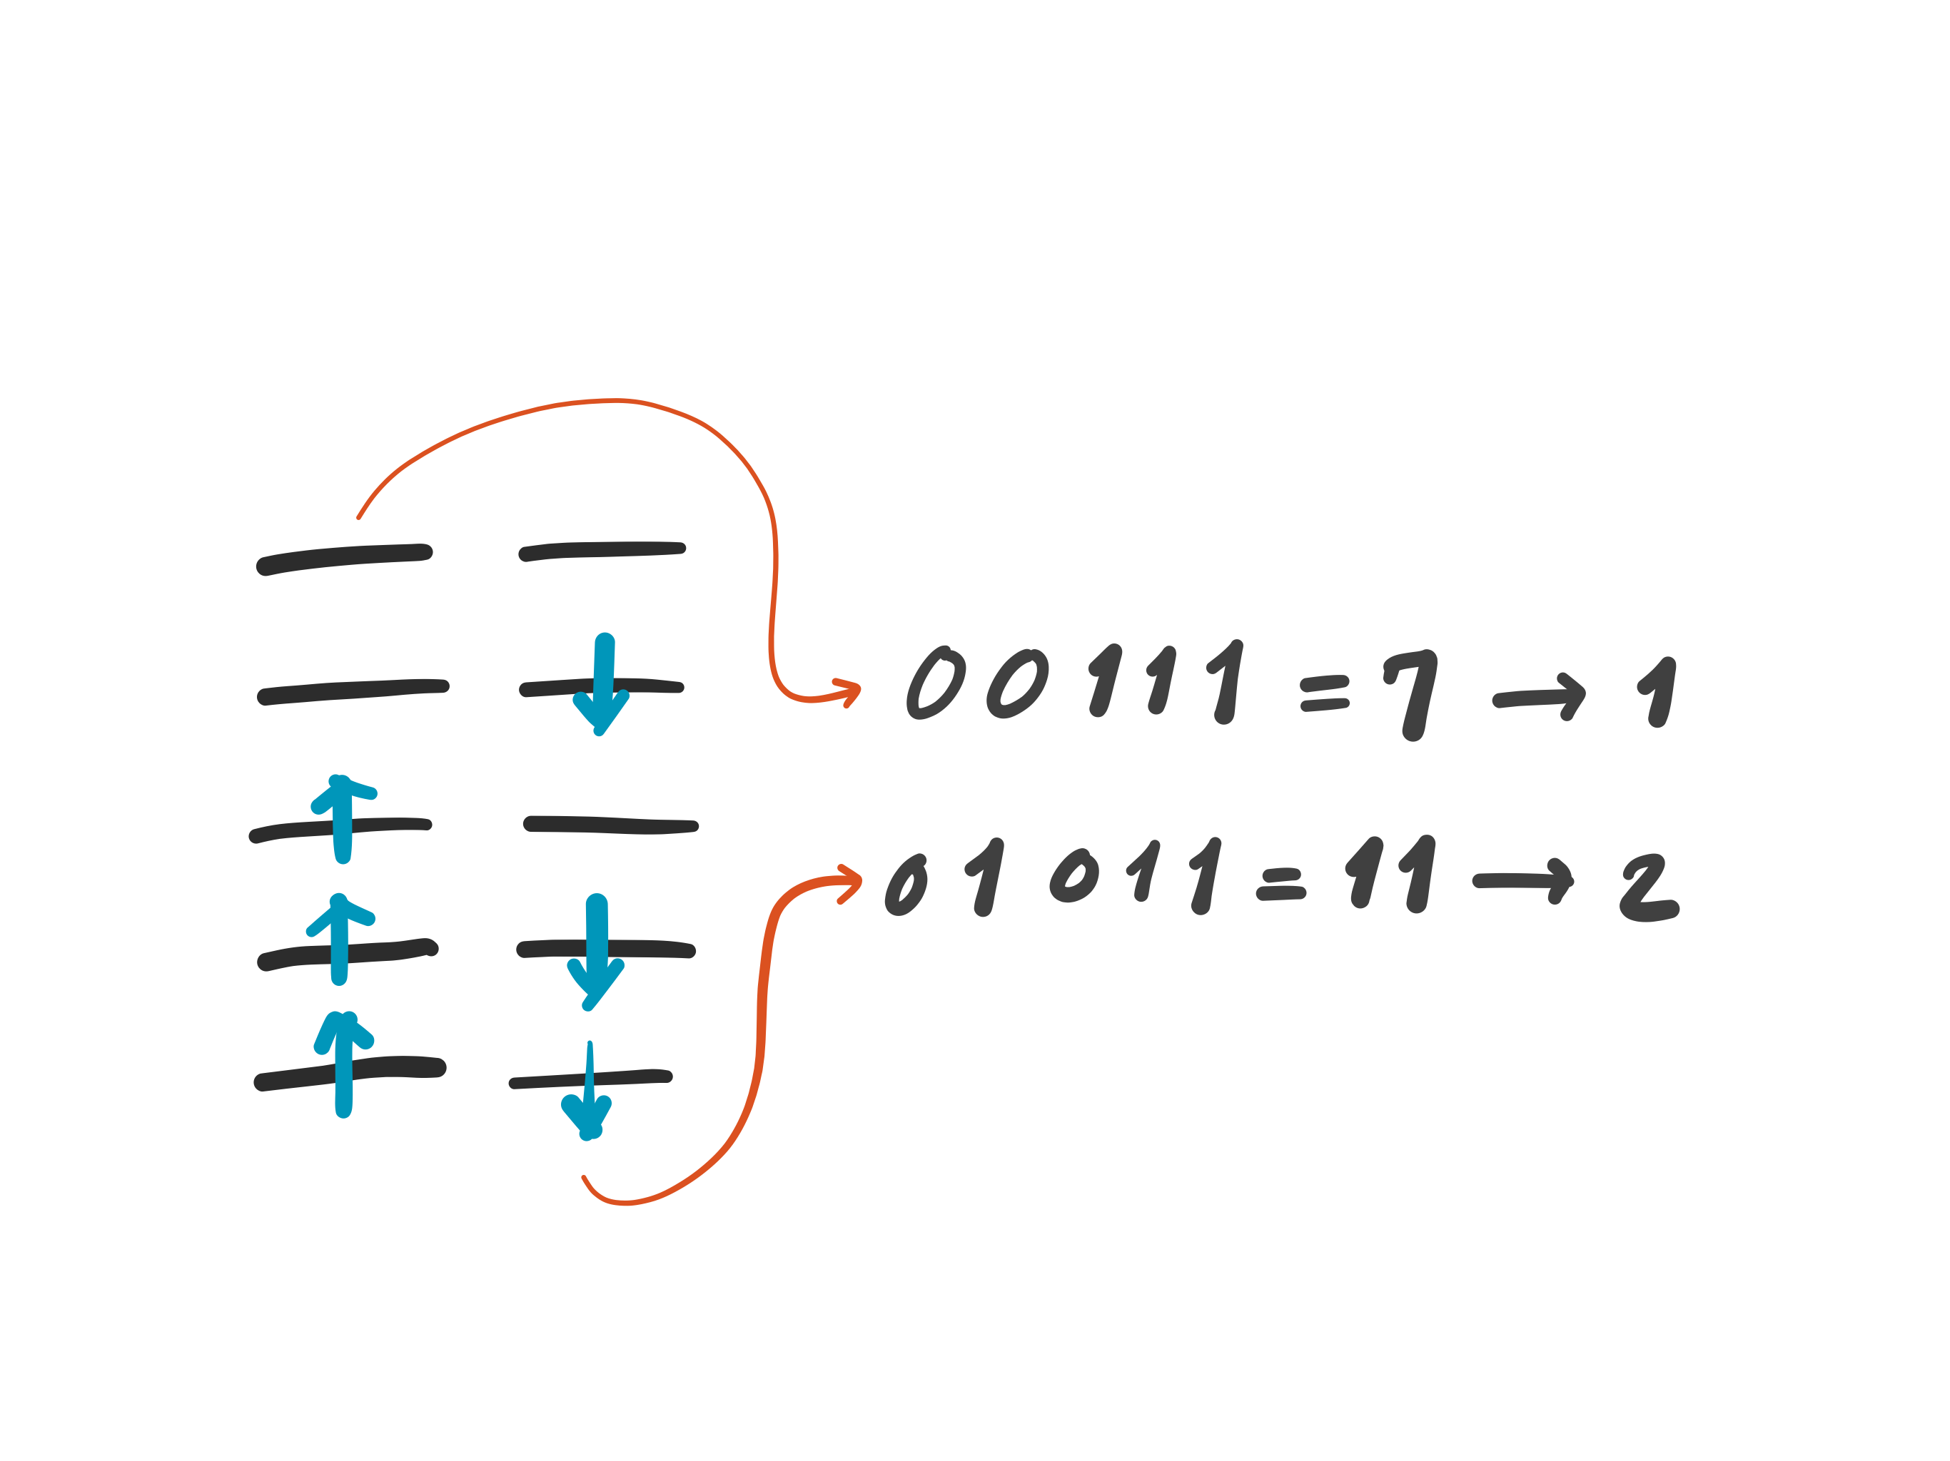
General-order CI
Determinant-based full configuration interaction
  Knowles and Handy, Chem. Phys. Lett. 1984.
String Address
Peter Knowles
Cardiff

Slide 4
General-order MP
Determinant-based, general-order Møller-Plesset perturbation (MP) theory
  Knowles, Somasundram, Handy,
  and Hirao, Chem. Phys. Lett. 1985.
Peter Knowles
Cardiff

Slide 5
General-order CC
Determinant-based, general-order coupled-cluster (CC) theory
  Hirata and Bartlett, Chem. Phys. Lett. 2000.
  Kállay and Surján, J. Chem. Phys. 2000.
  Olsen, J. Chem. Phys. 2000.

Slide 6
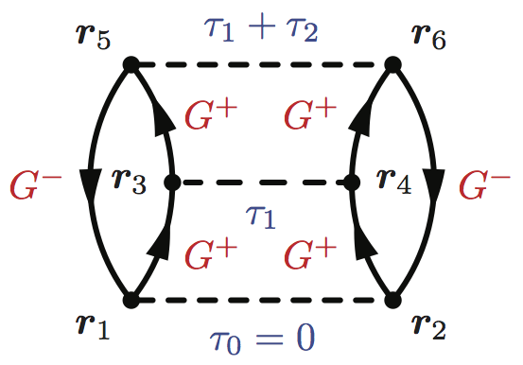
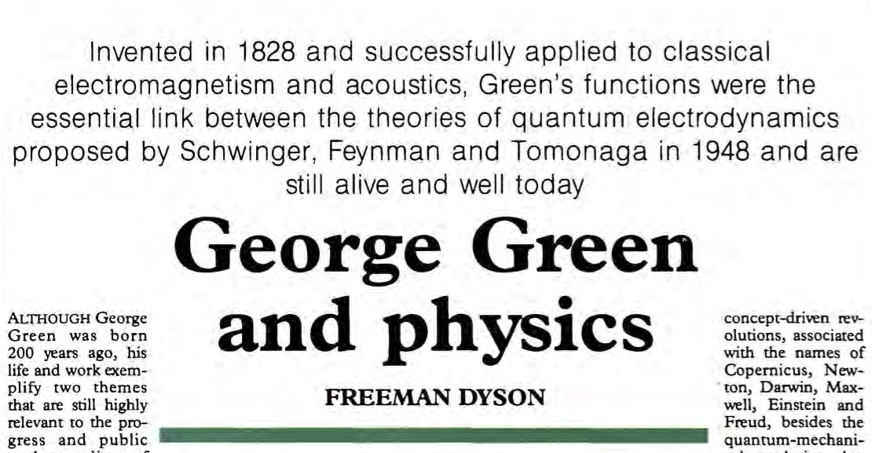
Green’s functions
Richard Feynman
Computers
Telescopes
X-ray
Freeman Dyson

Slide 7
MBGF for chemistry
A disparate style of explaining MBGF (as opposed to CI, MBPT, CC).
  Dyson equation versus Schrödinger equation
  Diagrammatic versus algebraic
Absence of algebraic recursive definitions (in the style of the recursions in Rayleigh-Schrödinger perturbation theory).
  General-order implementation
  Justifications of diagrammatic rules

Slide 8
MBGF in 8 pages (1/8)
Exact N-electron
GS wfn
Green’s function
#MO x #MO matrix
IP sector
EA sector
Exact N-electron GS energy
Exact N–1-electron nth state wfn
Poles at exact IP
Poles at exact EA

Slide 9
MBGF in 8 pages (2/8)
Perturbation expansion
Møller–Plesset partitioning
HF N-electron GS wfn
Zeroth-order N-electron GS energy

Slide 10
MBGF in 8 pages (3/8)
Dyson equations
Dyson equation
Dyson equation (long)
Inverse Dyson equation
Inverse Dyson equation (for ω)

Slide 11
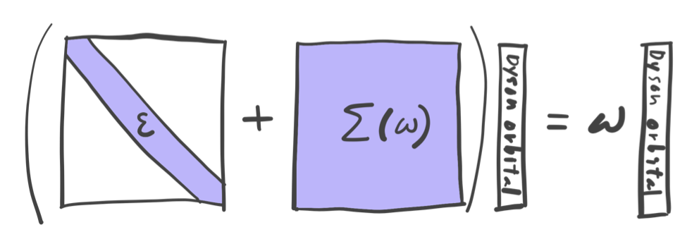
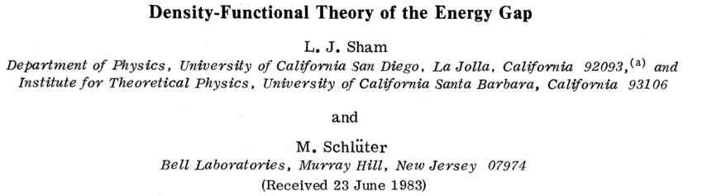
MBGF in 8 pages (4/8)
Inverse Dyson equation
at exact IP/EA
Exact one-particle equation: Dyson equation

Slide 12
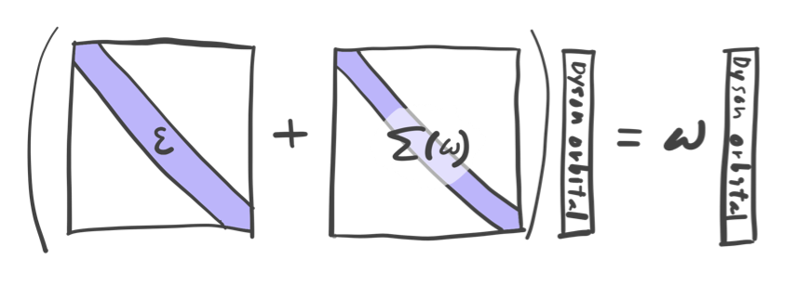
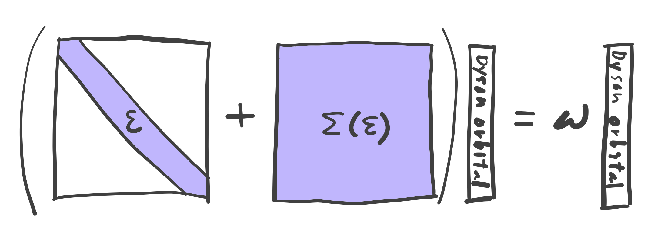
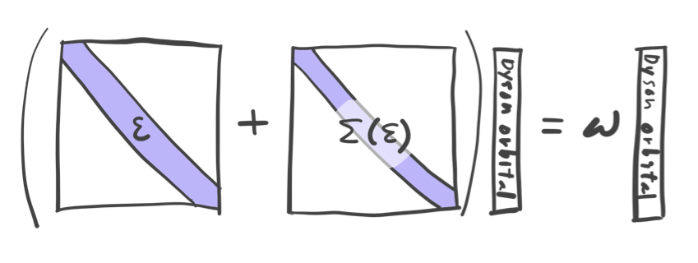
MBGF in 8 pages (5/8)
Approximations
Diagonal
ω-independent
Diagonal, ω-independent

Slide 13
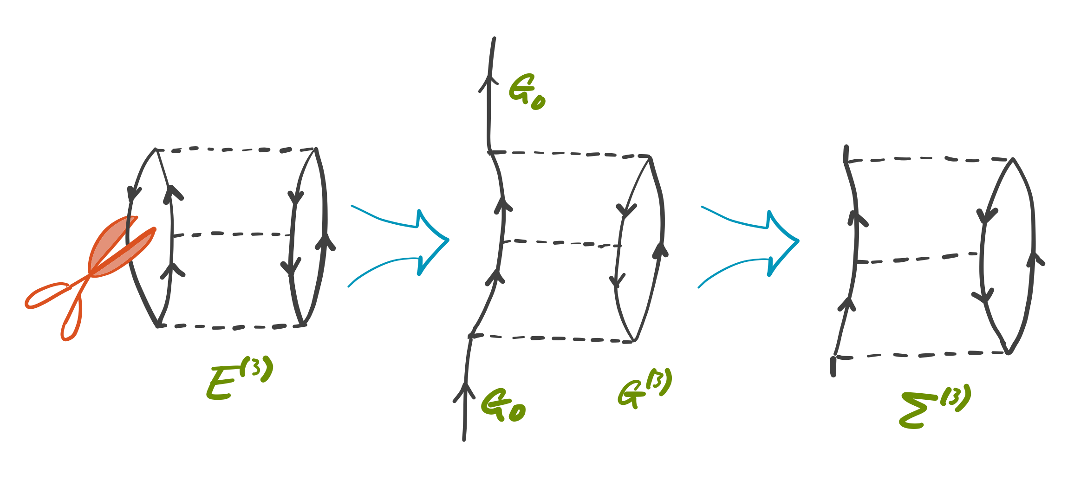
MBGF in 8 pages (6/8)
Diagrammatics: rule #1 (opening of linked diagrams)
Cutting a line of a MP diagram and trimming the dangling lines (the resulting diagram is linked and size consistent)

Slide 14
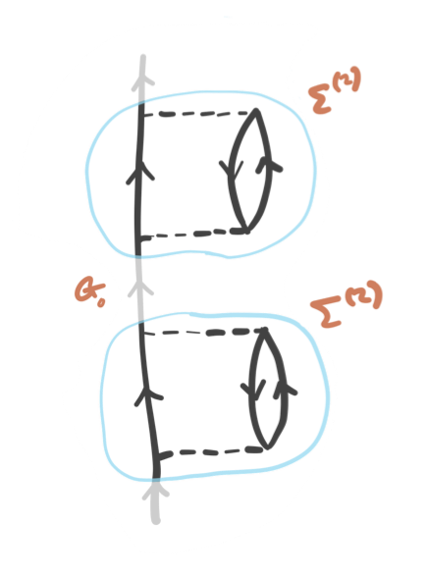
MBGF in 8 pages (7/8)
Diagrammatics: rule #2 (irreducible-only)
Exclusion of reducible diagrams (so that no over-counting)

Slide 15
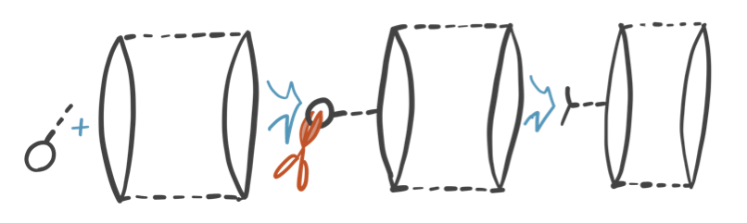
MBGF in 8 pages (8/8)
Diagrammatics: rule #3 (a vertex insertion)
A vertex (V) insertion (so that no under-counting)
12 GF3 diagrams
Simons and Smith
J. Chem. Phys. (1973)
6 additional GF3 diagrams
Purvis and Öhrn
Chem. Phys. Lett. (1975)

Slide 16
Algebraic definitions of MBGF and general-order algorithms

Slide 17
General-order MBGF #1: ΔMPn
General-order MP for N-electron system
General-order MP for N±1-electron system
Diagonal, frequency-independent self-energy
Pickup and Goscinski
Mol. Phys. (1973)
Hirata, Hermes, Simons and Ortiz
J. Chem. Theory Comput. (2015)

Slide 18



General-order MBGF #1: ΔMPn
ΔMPn agrees with diagonal, ω-independent self-energy at n = 0 through 3, but switches to the full (exact) self-energy at n = ∞
Matt Hermes
UIUC
BH HOMO
r = 1.232 Å
the minimal basis
frozen core
Vince Ortiz
Auburn
Jack Simons
Utah
Hirata, Hermes, Simons and Ortiz
J. Chem. Theory Comput. (2015)

Slide 19
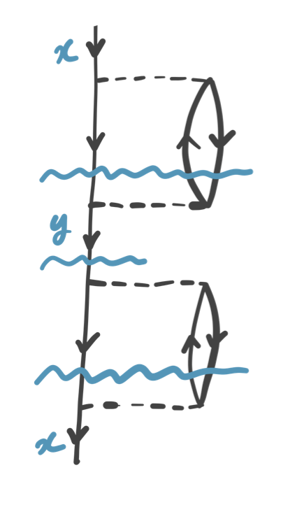
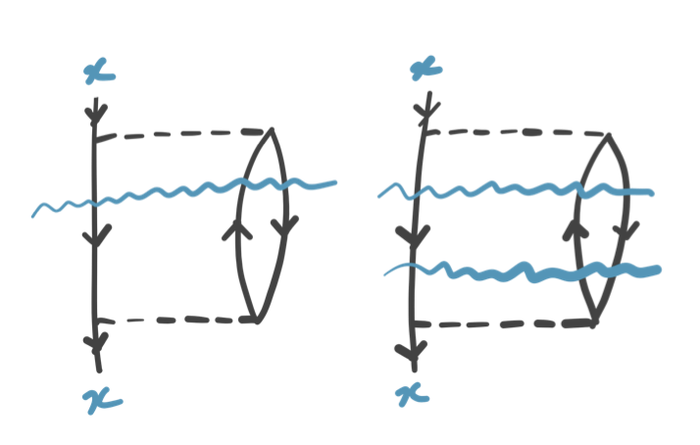
General-order MBGF #1: ΔMPn
Semi-reducible diagram
(corrects diagonal approximation error)
Linked-disconnected diagram
(corrects ω-independent approximation error)
Hirata, Hermes, Simons and Ortiz
J. Chem. Theory Comput. (2015)

Slide 20
General-order MBGF #2 ~ #4
Could the diagrammatic rules be ignoring important classes of diagrams? Could the diagrammatic MBGF be wrong?
#2 : Gell-Mann–Low time-dependent perturbation theory – fail
#3 : diagram reverse engineering – fail
#4 : superoperator algebra – fail

Slide 21
Backstory of general-order MP
FCI with modified H
Numerical differentiation
Peter Knowles
Cardiff
  Knowles, Somasundram, Handy and Hirao, Chem. Phys. Lett. 1985.

Slide 22
General-order MBGF #5: λ-variation
FCI / hp-FCI with modified H
Numerical differentiation
Hirata, Doran, Knowles and Ortiz (2017)

Slide 23

General-order MBGF #6: diagrams
λ-variation
Diagrams
F. Dyson prevails!
Agreement
Agreement
Agreement
Agreement
Alex Doran
UIUC
Doran and Hirata (2017)

Slide 24
General-order MBGF #7: recursion 1
General-order MP for N-electron system
General-order MP for N–1-electron system for all states
Hirata, Doran, Knowles and Ortiz (2016)

Slide 25
General-order MBGF #7: recursion 1
Hirata, Doran, Knowles and Ortiz (2017)

Slide 26
General-order MBGF #7: recursion 2
As long as the (N±1)-electron wave functions span complete space, they can just be single determinants, simplifying recursions considerably.
Hirata, Doran, Knowles and Ortiz (2017)

Slide 27
General-order MBGF #7: recursion 3
A biorthogonal expansion clarifies the relation between ΔMPn and MBGF; shows the difference at n = 4 as semi-reducible and linked-disconnected diagrams.
ΔMPn
Hirata, Doran, Knowles and Ortiz (2017)

Slide 28
Linked-diagram theorem for MBGF
Unlinked diagrams mutually cancel exactly, justifying the diagrammatic rule #1 (linked-only) and size consistency.
Hirata, Doran, Knowles and Ortiz (2017)

Slide 29
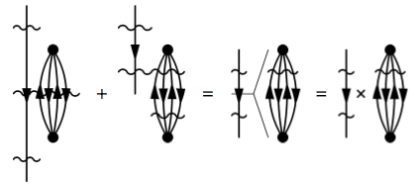
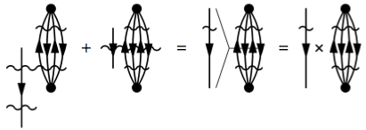
Factorization theorem
Cancelations of unlinked diagrams with different time orderings due to factorization.
Frantz and Mills (1960); Hirata, Doran, Knowles and Ortiz (2017)

Slide 30
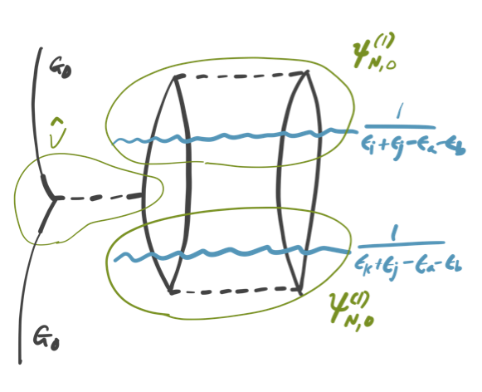
Vertex insertion
The number of V is not equal to the perturbation order, justifying diagrammatic rule #3 (a vertex insertion).
Hirata, Doran, Knowles and Ortiz (2017)

Slide 31
General-order MBGF #7: self-energy
Dyson equation
Perturbative expansions
Recursion for self-energy
Frantz and Mills (1960); Hirata, Doran, Knowles and Ortiz (2017)

Slide 32
Irreducible-diagram theorem for Σ
Single G⁽⁰⁾ lines can be factored, justifying the trimming of dangling lines and diagrammatic rule #2 (irreducible only).
Hirata, Doran, Knowles and Ortiz (2017)

Slide 33
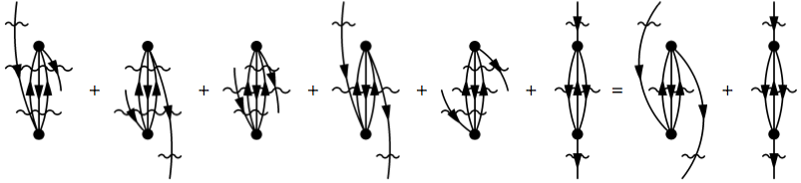
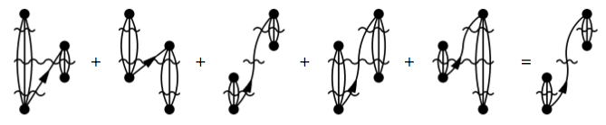
Factorization theorem
Trimming of dangling lines and removal of reducible diagrams due to factorization.
Frantz and Mills (1960); Hirata, Doran, Knowles and Ortiz (2017)

Slide 34
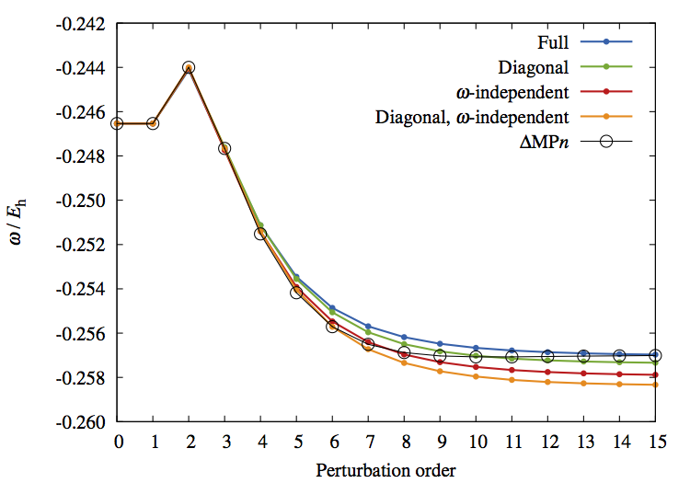
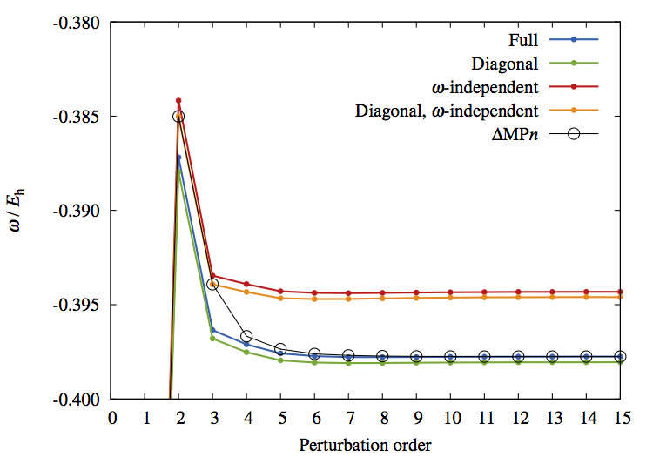
General-order MBGF: Koopmans
BH HOMO
the minimal basis
frozen core
H₂O HOMO–1
the minimal basis
frozen core
Hirata, Doran, Knowles and Ortiz (2017)

Slide 35
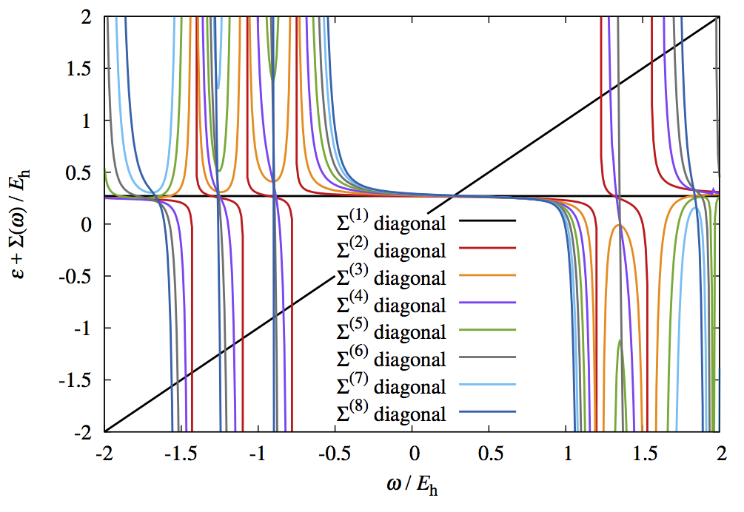
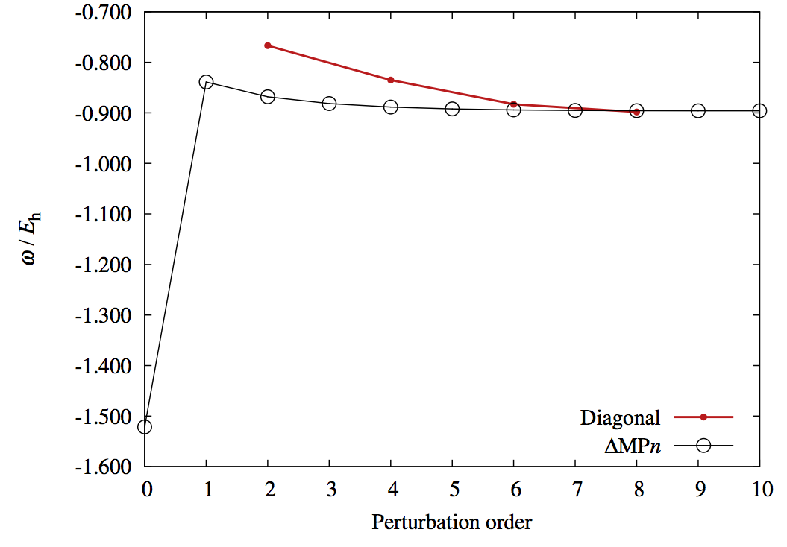
General-order MBGF: Satellite
BH non-Koopmans
the minimal basis
frozen core
Hirata, Doran, Knowles and Ortiz (2017)

Slide 36
Conclusion
3 recursive definitions for Green’s function.
1 recursive definition for self-energy.
6 general-order algorithms (ΔMPn, λ-variation, diagrams, 3 recursions).
Linked-diagram theorem for Green’s function.
Irreducible-diagram theorem for self-energy.
Rationalized 3 diagrammatic rules of MBGF.
Rationalized differences between ΔMPn and MBGF (in terms of semi-reducible and linked-disconnected).

