Slide 1
School of Chemical Sciences
Support Facilities

Slide 2
Danielle Gray
Associate Director of CORES dgray@illinois.edu
217-244-1708

Slide 3
Center
Of
Research and
Educational
Support

Slide 5
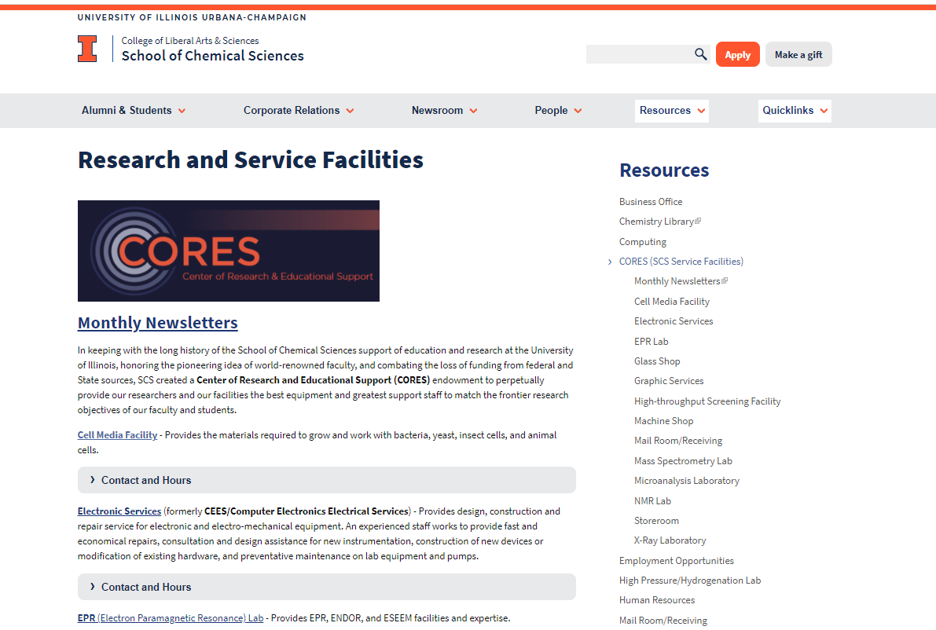
scs.illinois.edu

Slide 6
Cell Media - 491 Roger Adams Lab
Prepares substrates for growing and working with cells, bacteria, and yeast.
Dr. Sandy McMasters
smattick@illinois.edu
217-244-5898

Slide 7
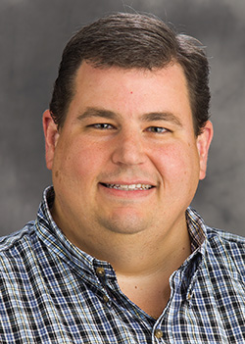
Computing- 125 Noyes Lab
Troubleshoot phone, computer, networking, computer infrastructure, and set up clusters for computational theories.
comupting@scs.illinois.edu
217-244-7515

Slide 8
ES – 121,76,125,113A Noyes Lab
Electronic Service
Repair for all manner electronic and/or mechanical instruments and fabricating novel devices
scs-es@mx.uillinois.edu

Slide 9
Glass Shop- 114 Noyes Lab
Repair, modify, and fabricate scientific glassware that are not commercially available.
Andy Gibbs
agibbs@illinois.edu
217-333-3610

Slide 10
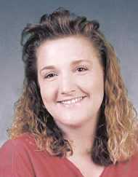
Graphic Services- 71 Noyes Lab
Custom scientific graphics, digital imaging and graphic design services for research, instruction, publication, grants and seminars.
Dorothy Loudermilk
loudermi@illinois.edu
217-244-1784

Slide 11
Machine Shop- B71 RAL
Build and repair ultra-high vacuum, high pressure, optical and mechanical equipment. Help is also available in the design of new equipment. Student Machine Shop (48 NL) available to trained individuals.
David Williams scs-machineshop@illinois.edu
217-333-4278

Slide 12
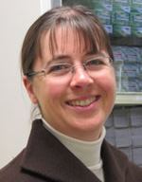
Storeroom- 94 Roger Adams Lab
Chemicals, glassware, and all manner of research and safety supplies are available for purchase with departmental funds. Please see the staff to be set-up as a user.
Karla Southern
ksouther@illinois.edu
217-333-3564

