Slide 1
Quantum field theory in chemistry
So Hirata
Department of Chemistry

Slide 2
Quantum field theory
Richard Feynman
Freeman Dyson

Slide 3
Schrödinger equation for benzene
Many-body
For benzene (42 electrons and 12 nuclei), this is a 126-dimensional partial differential equation for electrons only with a symmetry condition with 1.4 x 10⁵¹ terms.
Singular
It is also highly singular (1,365 singularities)
Notes:
Let me start with the basics. My job and Thom’s also is to solve Schrodinger equation. We tend to forget how amazing it is that we can do so with the kind of accuracy we can achieve. Because, even for benzene, this is a 126 dimensional partial differential equation with 1365 singularities at electron-electron or electron-nucleus coalescence. So if we view this as a naïve computational problem and try to solve this with a naïve Cartesian grid, with just 10 grid points per dimension, you would need a complex array of length 10 to 126th just to store the solution. So this is really hopeless unless you recognize that this is a chemical problem and you can subtract a priori knowledge of the structure of the wave function from this.

Slide 4
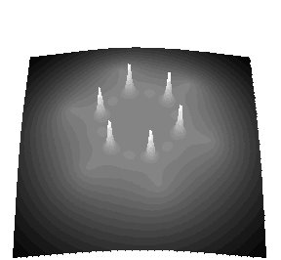
Nuclear-electron singularities
Basis function
Benzene electron density
AO basis | H₂O HF energy
aug-cc-pVDZ | –76.039804
aug-cc-pVTZ | –76.058816
aug-cc-pVQZ | –76.064122
aug-cc-pV5Z | –76.065429
AO basis | Ne MP2 energy
aug-cc-pVDZ | 65 %
aug-cc-pVTZ | 85 %
aug-cc-pVQZ | 93 %
aug-cc-pV5Z | 96 %

Slide 5
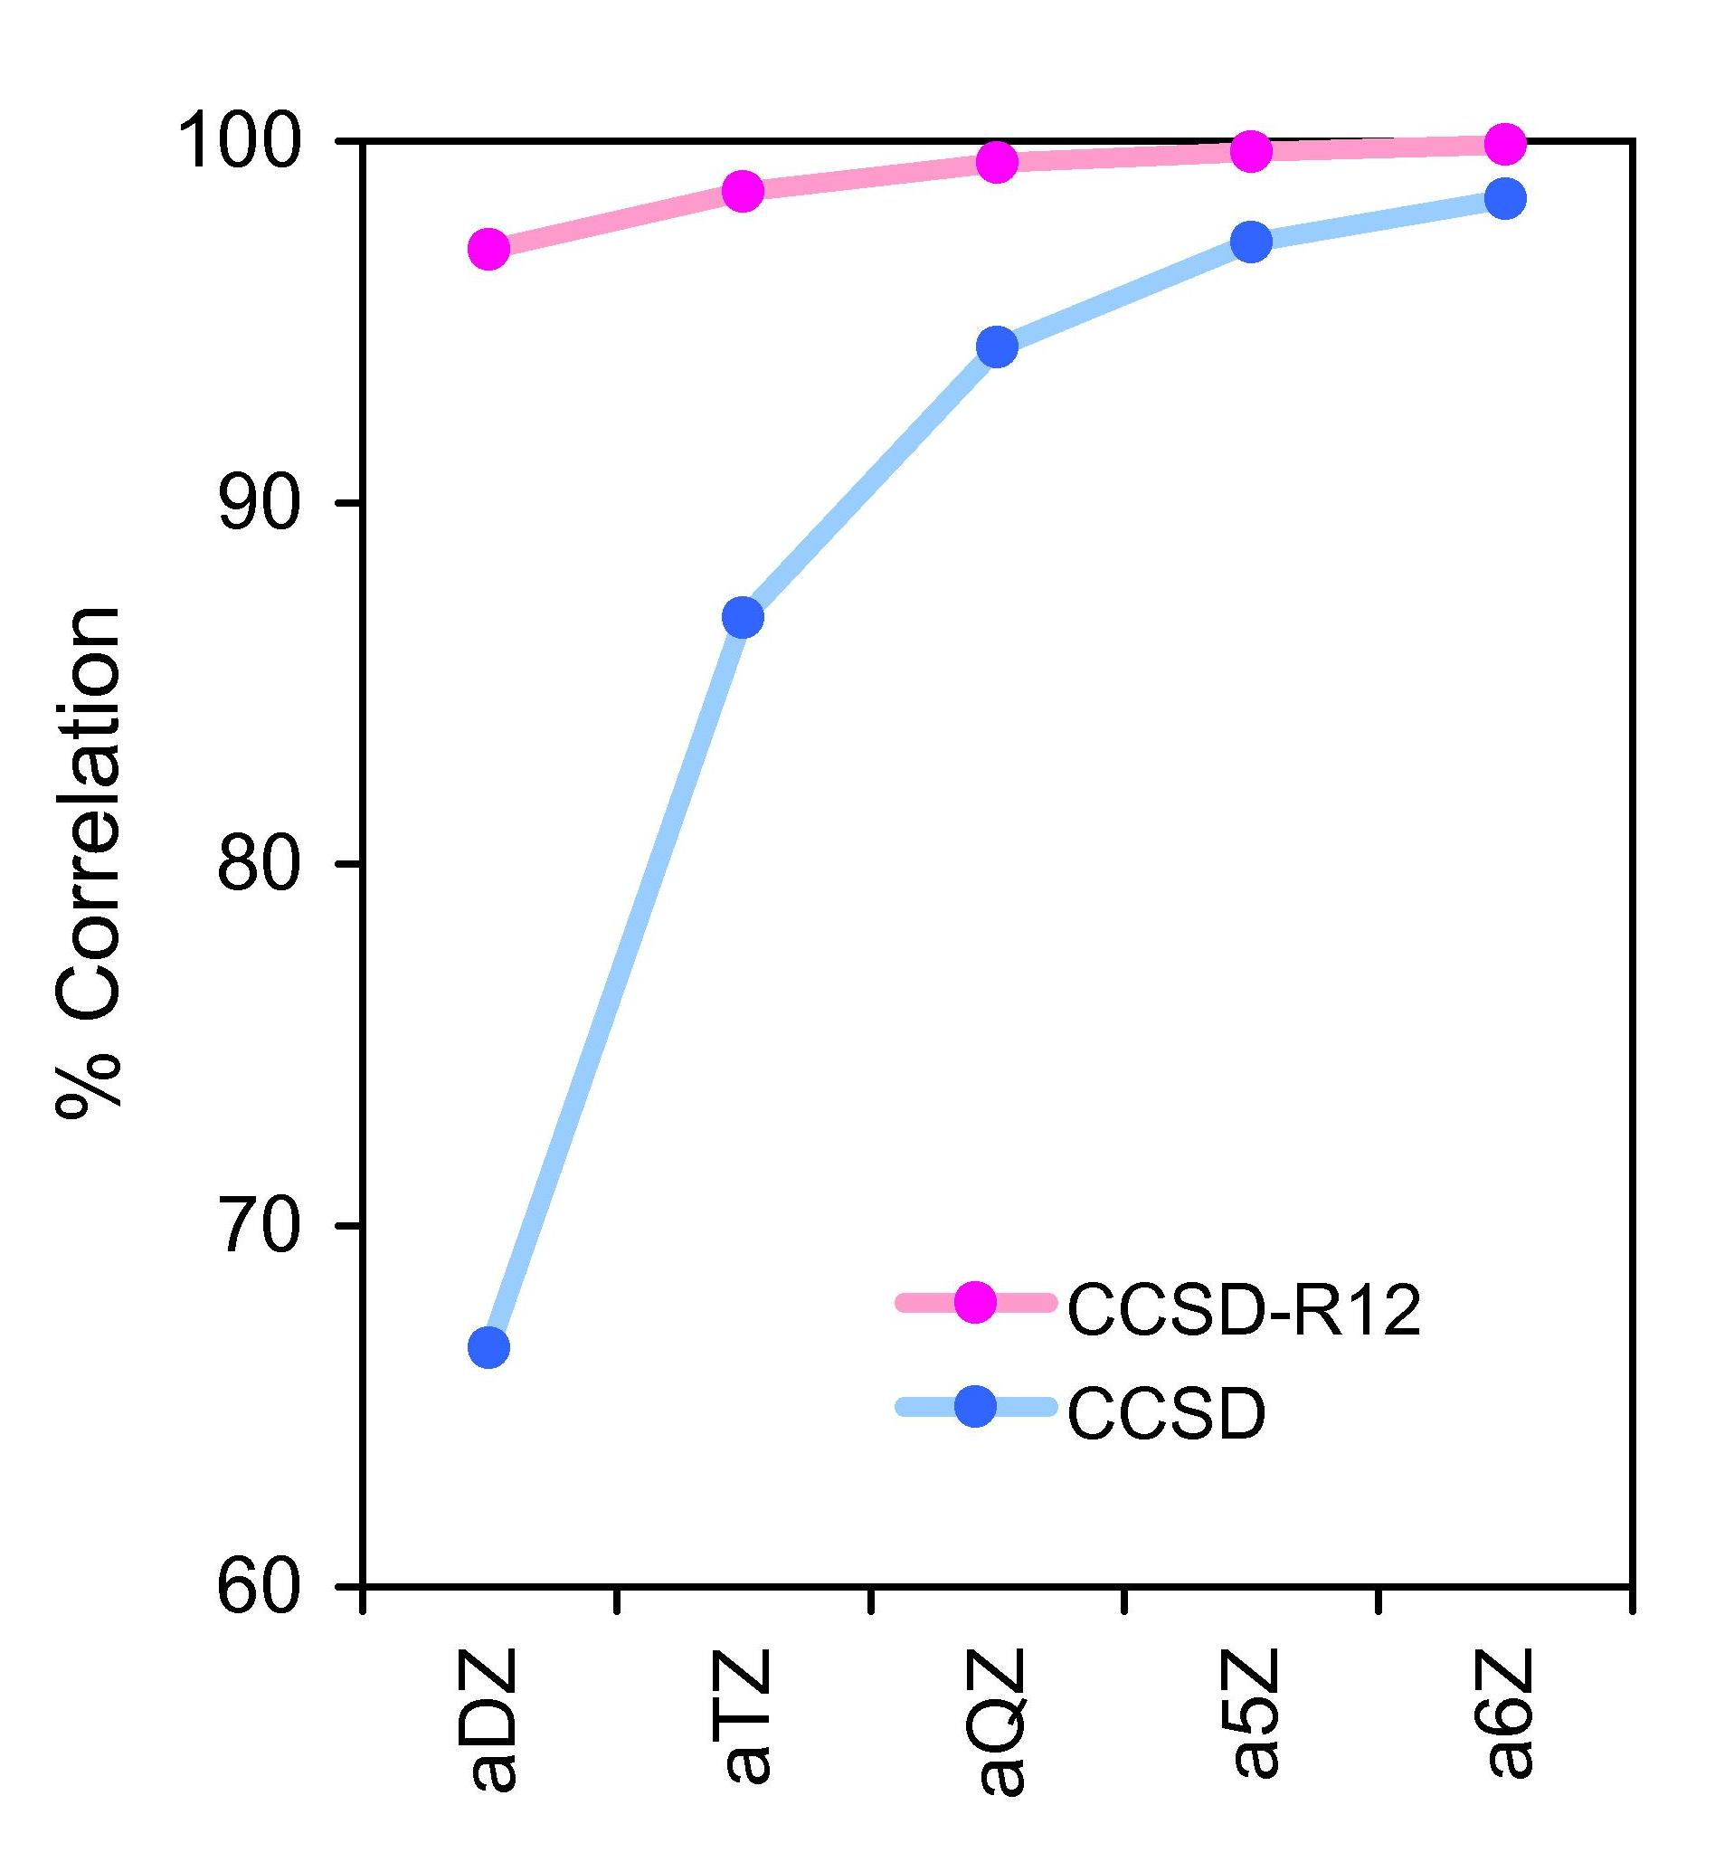
Electron-electron singularities
Cancel the singular Coulomb operator
Ne
Explicitly correlated (R12) method
Explicitly correlated (F12) method
Cf. Hylleraas, Kutzelnigg, Noga, Klopper, Szalewicz, Jeziorski, Monkhorst, Taylor, Werner, Ten-no, Valeev, Manby, Tew, Kohn, Helgaker, Shiozaki, et al.; also the Jastrow factor in QMC

Slide 6
Many-body problems trivia
How many interacting bodies do we need to have a many-body problem?
Classical mechanics
0-body
1-body
2-body
3-body
Quantum mechanics
0-body
1-body
2-body
3-body
Life Life
0-body
1-body
2-body
3-body
Quantum electrodynamics
0-body
1-body
2-body
3-body
R. D. Mattuck “A Guide to Feynman Diagrams in the Many-Body Problems”

Slide 7
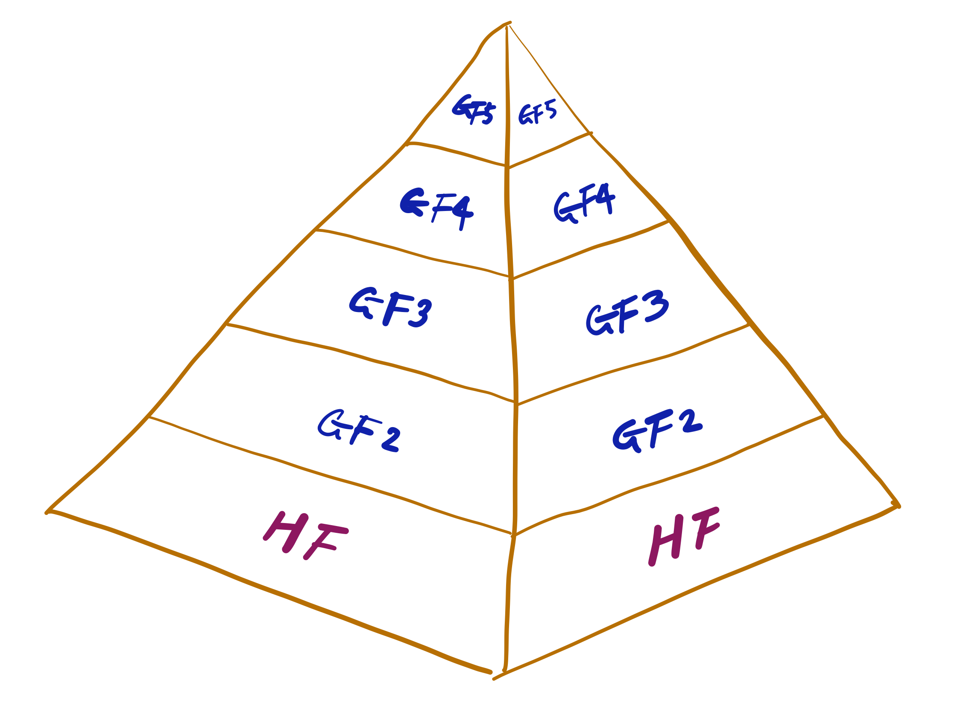
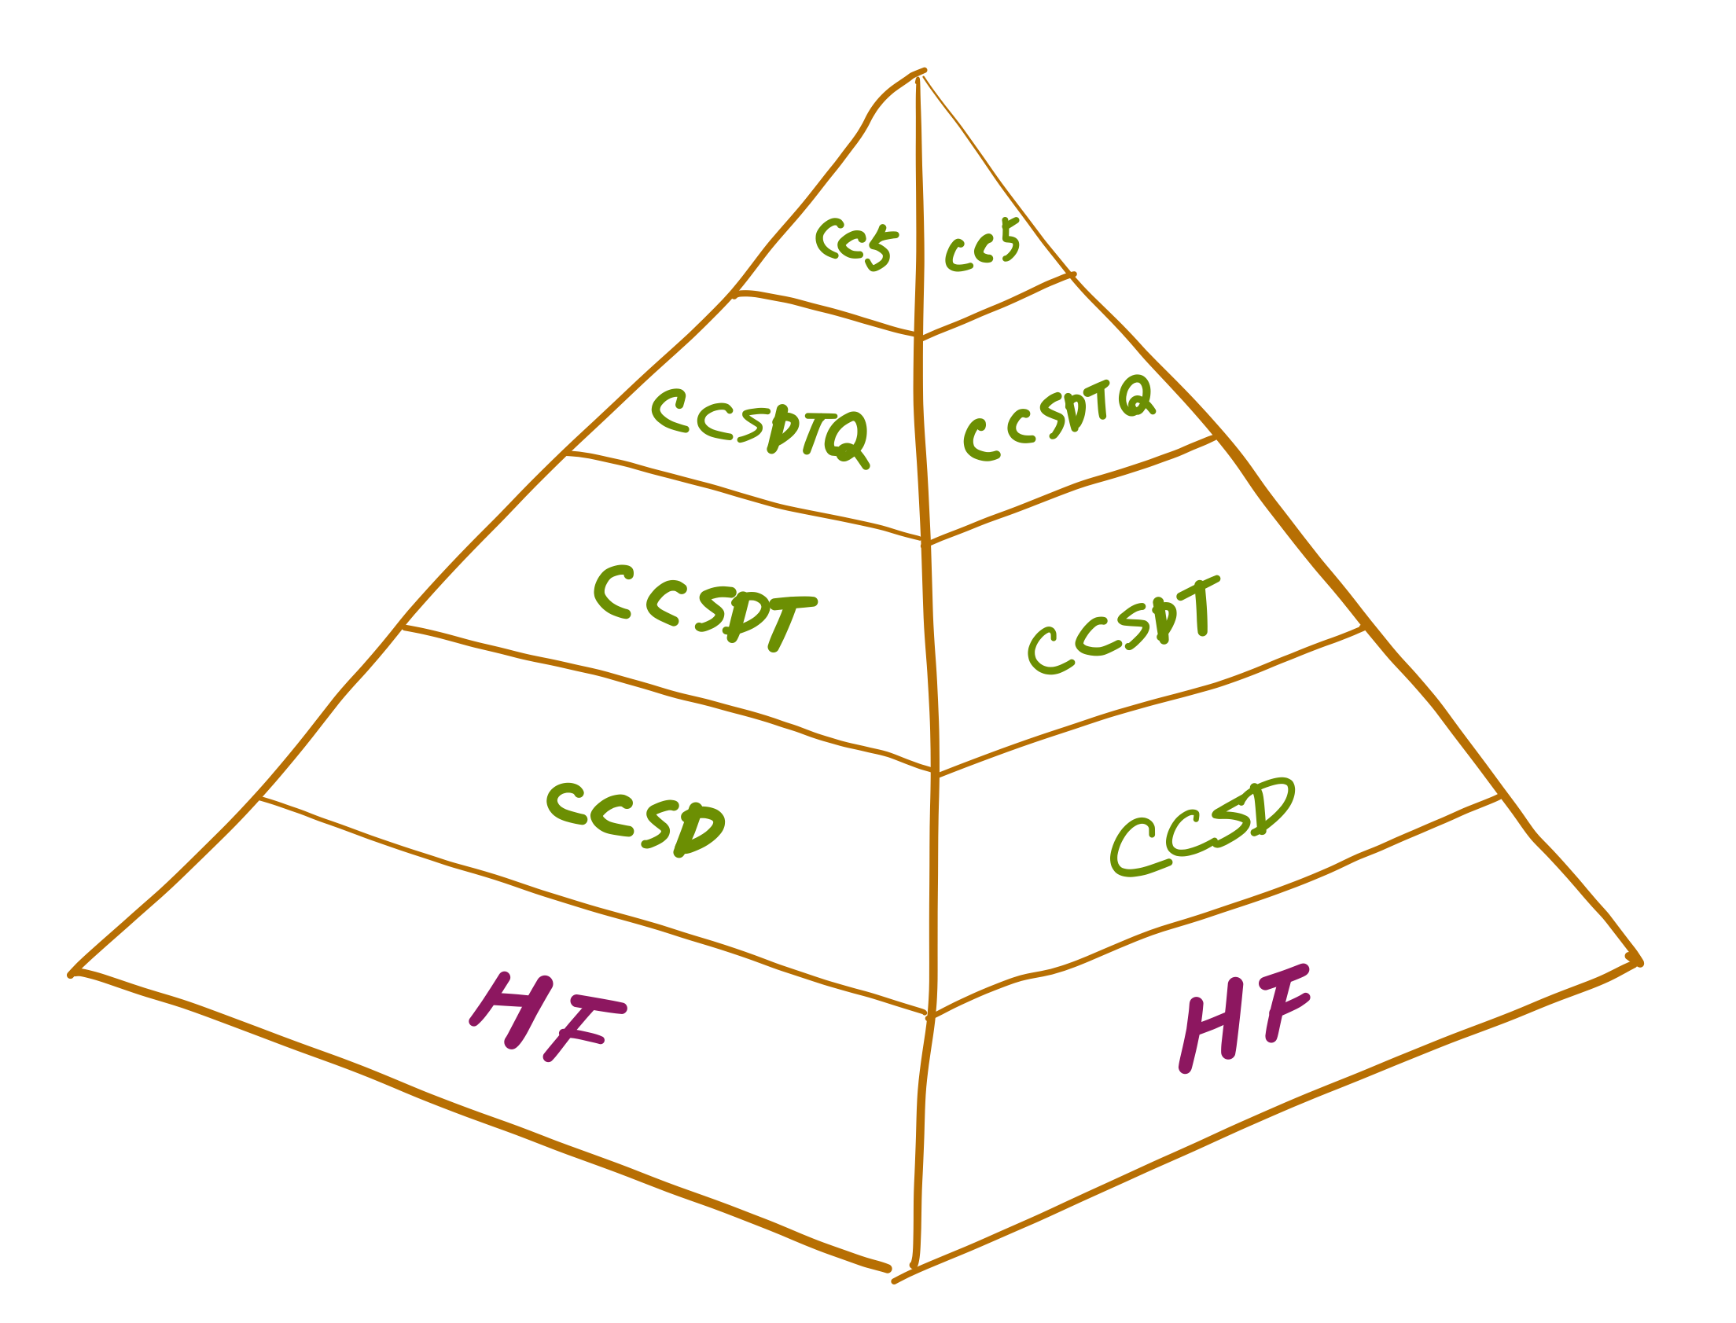
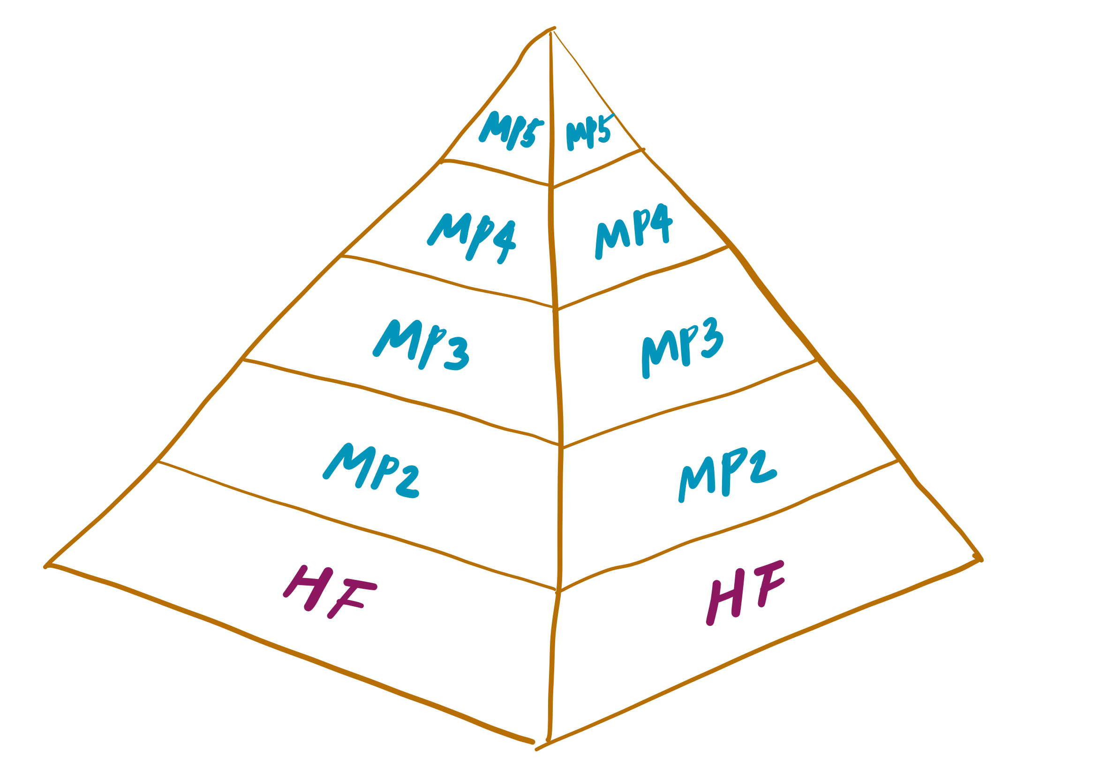
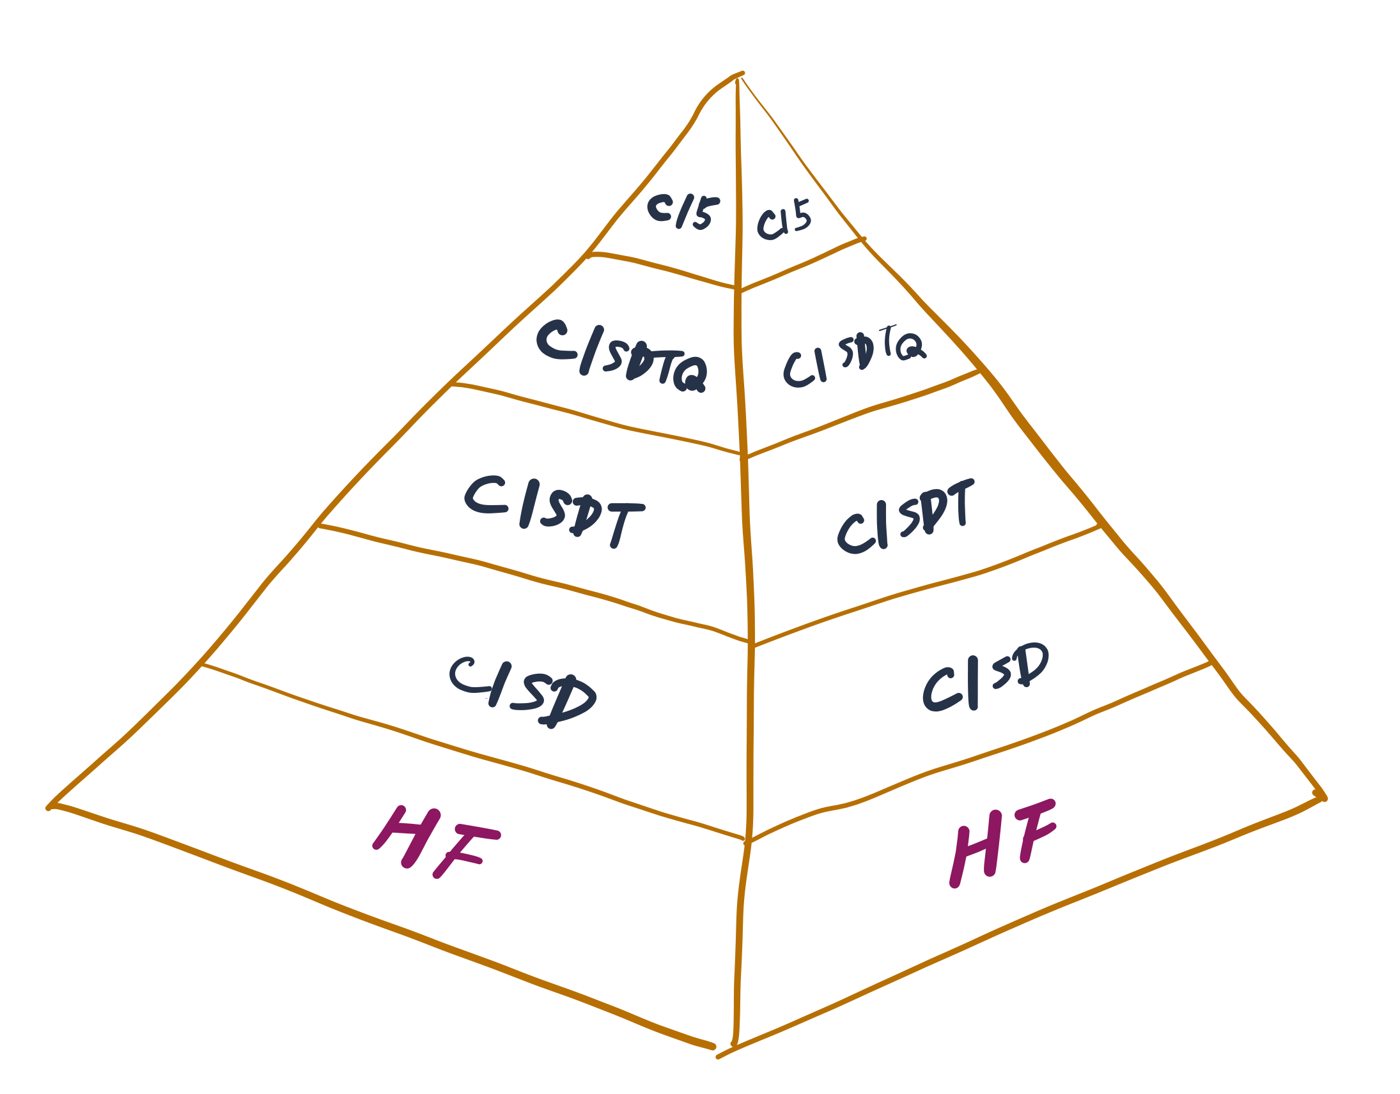
Rigorous many-body methods

Slide 8
CCSDT
CCSDT

Slide 9
CCSDT: first equation

Slide 10
CCSDT: second equation

Slide 11
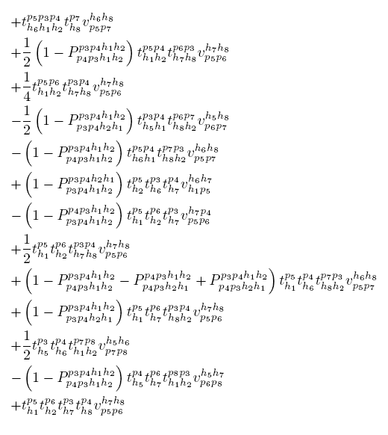
CCSDT: third equation

Slide 12
CCSDT: fourth equation

Slide 13
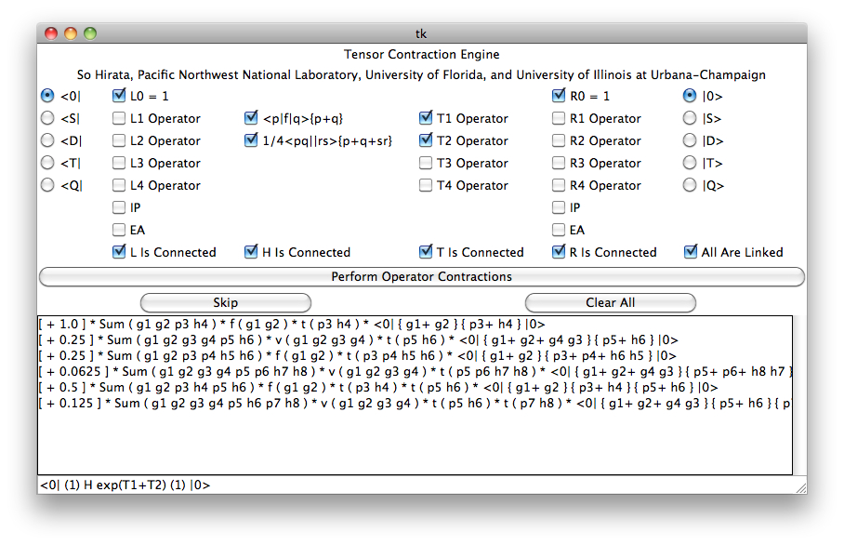
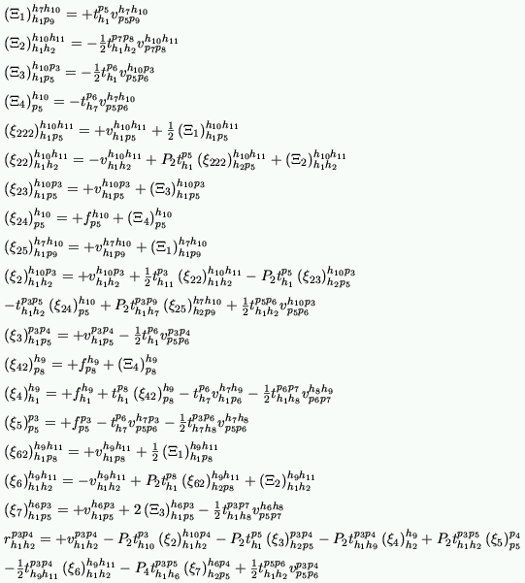
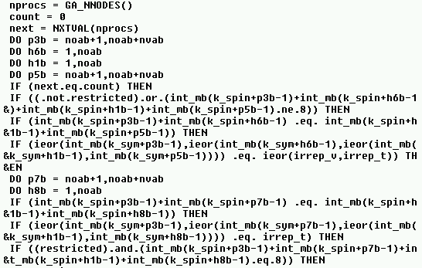
Automated symbolic algebra
Definition of a many-electron theory
Mathematical expressions
A parallel computer program

Slide 14
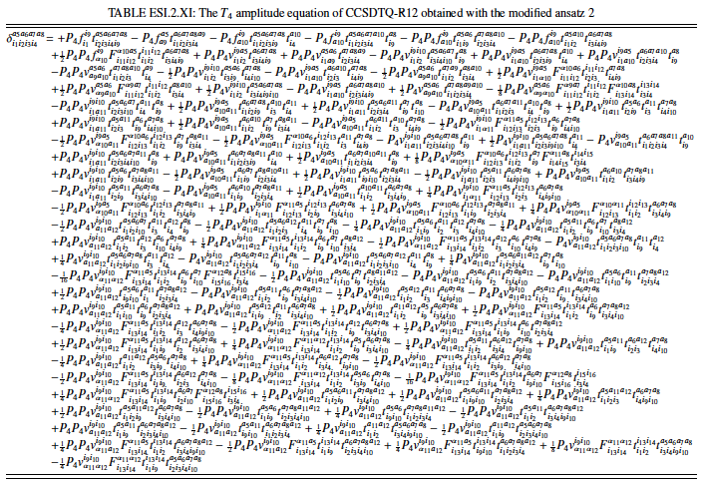
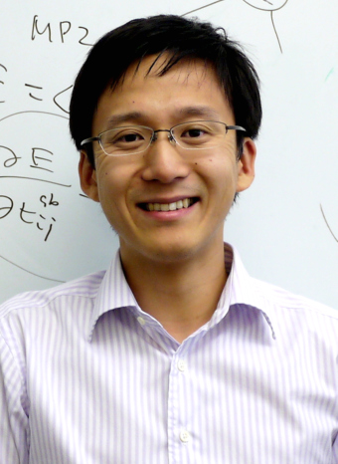
CCSDTQ-F12
Shiozaki, Kamiya, Hirata, and Valeev, Phys. Chem. Chem. Phys. (2008), J. Chem. Phys. (2008), J. Chem. Phys. (2009).
Toru Shiozaki
Northwestern

Slide 15
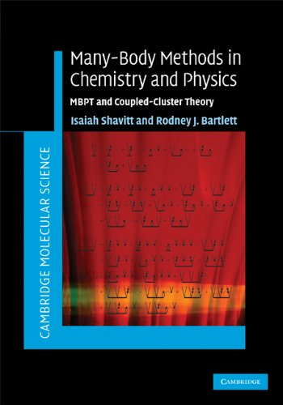
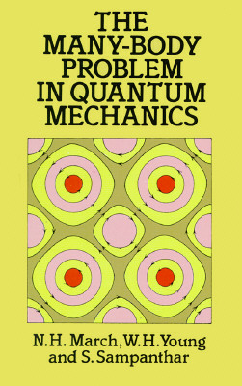
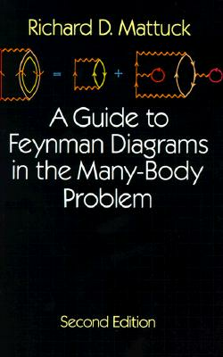
Quantum field theory
First quantization (Slater-Condon rules)
Second quantization
Normal ordering & Wick’s theorem
Feynman-Goldstone diagrams

Slide 16
1. First-quantized basis functions
Slater determinant
HF spinorbital
spinorbital coordinate
Hartree product
Observations
These mean-field wave functions serve as a basis for all derivation tools
Harmonic oscillator wave function
Normal mode

Slide 17
First-quantized Hamiltonians
ab initio electronic
ab initio vibrational
Force constant
Observations
Specific number and positions of particles/modes
Information about the mean field not used

Slide 18
Slater-Condon rules
Antisymmetrized two-electron integral
One-electron integral

Slide 19
Born-Huang rules

Slide 20
Case study: CIS
Observations
All possible cases of index coincidences need to be considered
Final results are neatly grouped into HF energy and Fock matrix elements
i, j, k, … occupied spinorbitals ;
a, b, c, … virtual spinorbitals ; p, q, r, s, either

Slide 21
2. Second-quantized basis functions
Slater determinant
Hartree product
Observations
Quantum field theory!
The number of electrons can be changed
The mean-field information built-in

Slide 22
Second-quantized Hamiltonians
Creation / annihilation operator
Observations
System-independent Hamiltonian
Symmetry logic in the operator
Harmonic frequency
Ladder operator

Slide 23
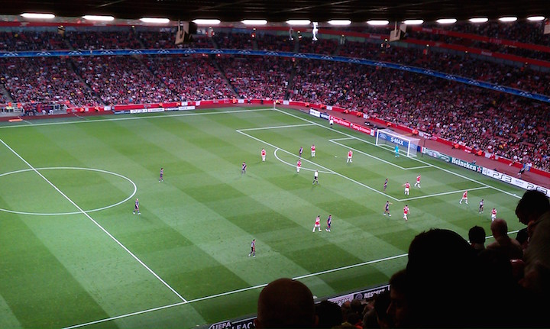

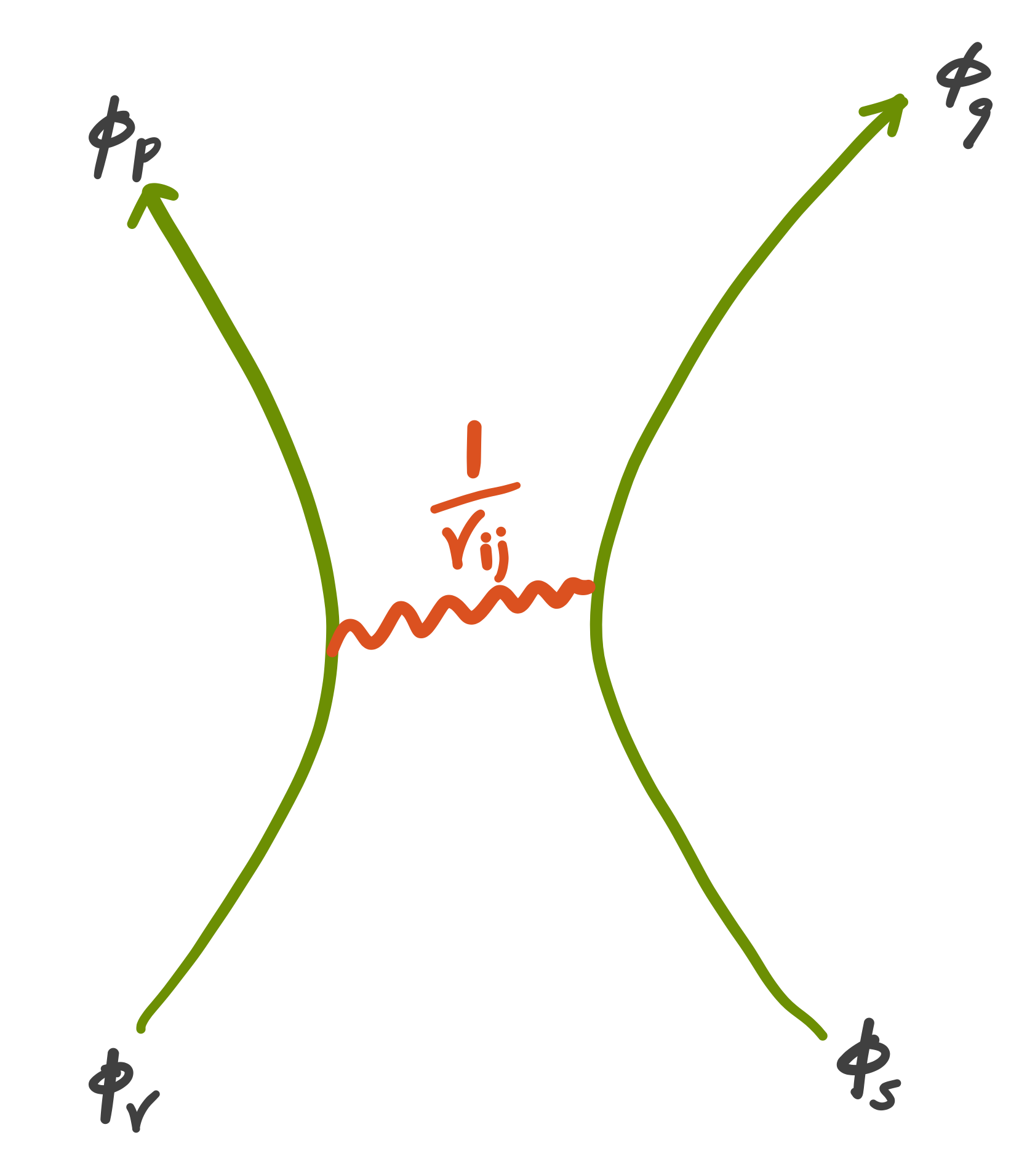
First versus second quantization

Slide 24
Case study: CIS
Anti-commutation relations
Double creation & double annihilation
Observations
It’s much worse than Slater-Condon rules!
All surviving contributions come from Kronecker δ
All other numerous swaps are to lead to double creation / annihilations and vanishing terms
Final results are neatly grouped into HF energy and Fock matrix elements

Slide 25
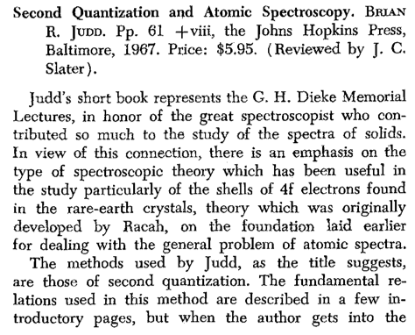
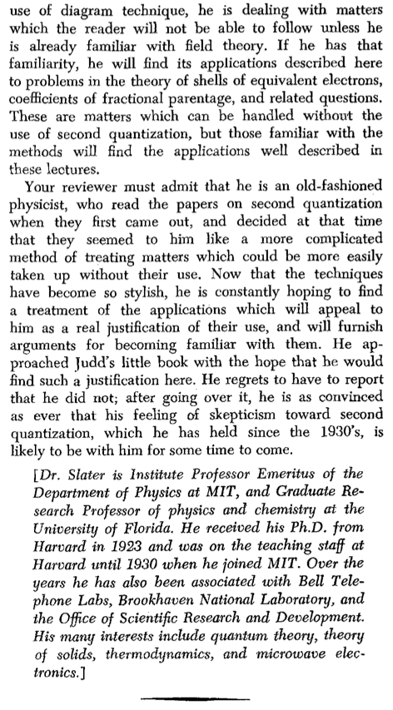
Second quantization
J. C. Slater, a book review
Am. J. Phys. (1968)

Slide 26
3. Normal ordering & Wick’s theorem
Desiderata
Double creation / annihilation to occur instantly
pairing to occur instantly
Terms grouped into HF energy and Fock matrix elements from the outset
Double creation & double annihilation
Normal ordering

Slide 27
Normal ordering & Wick’s theorem
Desiderata
Double creation / annihilation to occur instantly
pairing to occur instantly
Terms grouped into HF energy and Fock matrix elements from the outset
Wick’s theorem for a single normal-ordered sequence
Wick’s theorem for a product of normal-ordered sequences

Slide 28
Normal ordering & Wick’s theorem
Desiderata
Double creation / annihilation to occur instantly
pairing to occur instantly
Terms grouped into HF energy and Fock matrix elements from the outset
Second-quantized electronic Hamiltonian
Normal-ordered electronic Hamiltonian

Slide 29
Case study: CIS

Slide 30
Case study: CIS
Observations
Most expedient!
Already grouped!
Still 4-fold redundancy

Slide 31

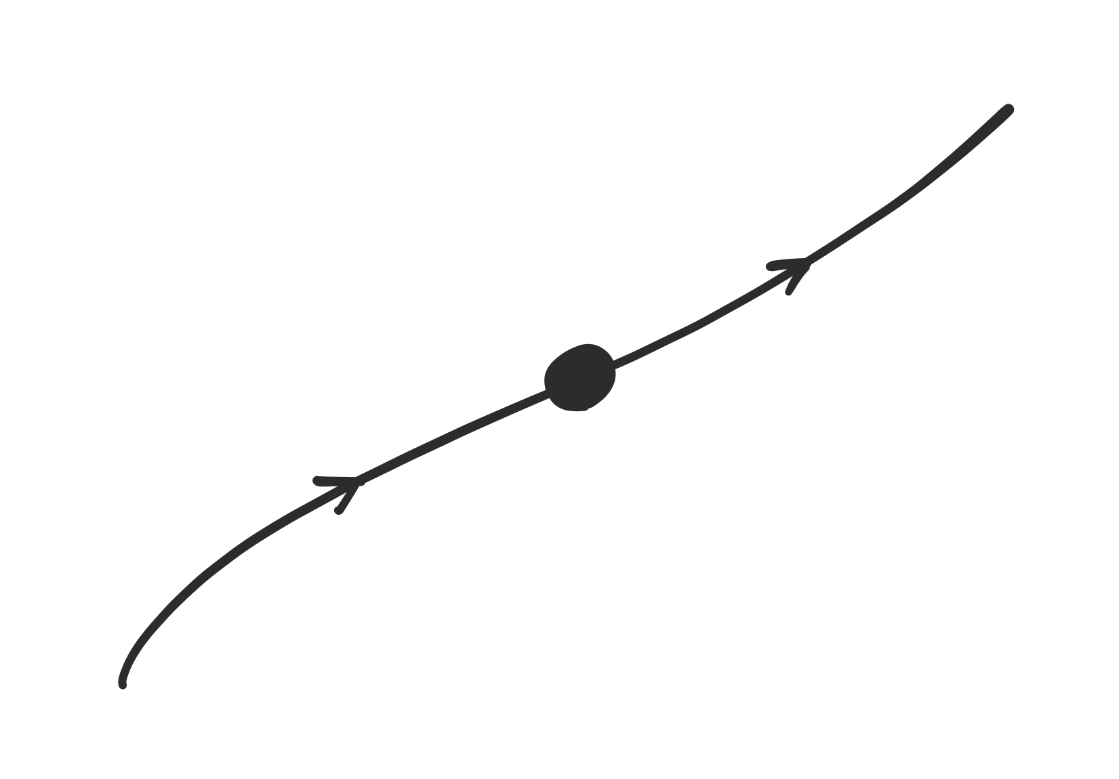
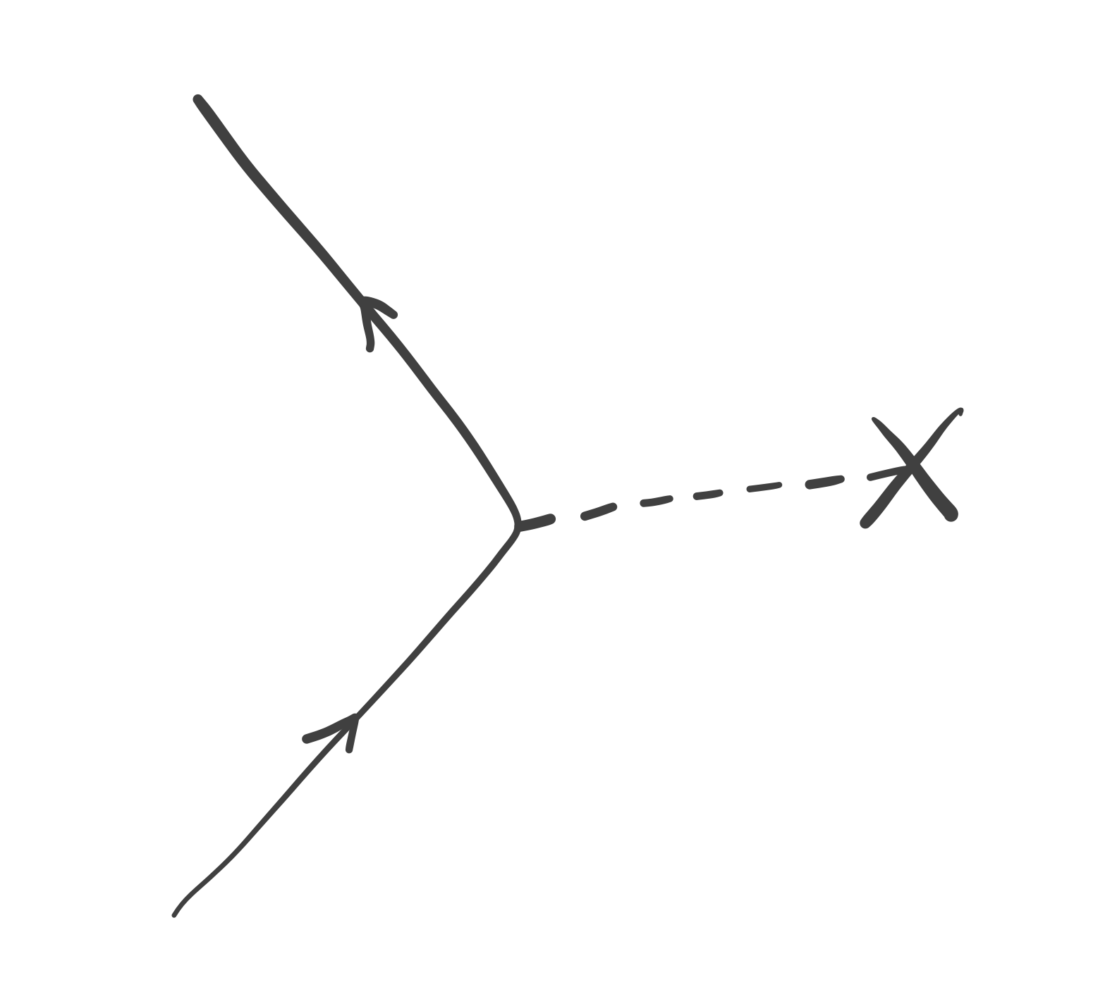
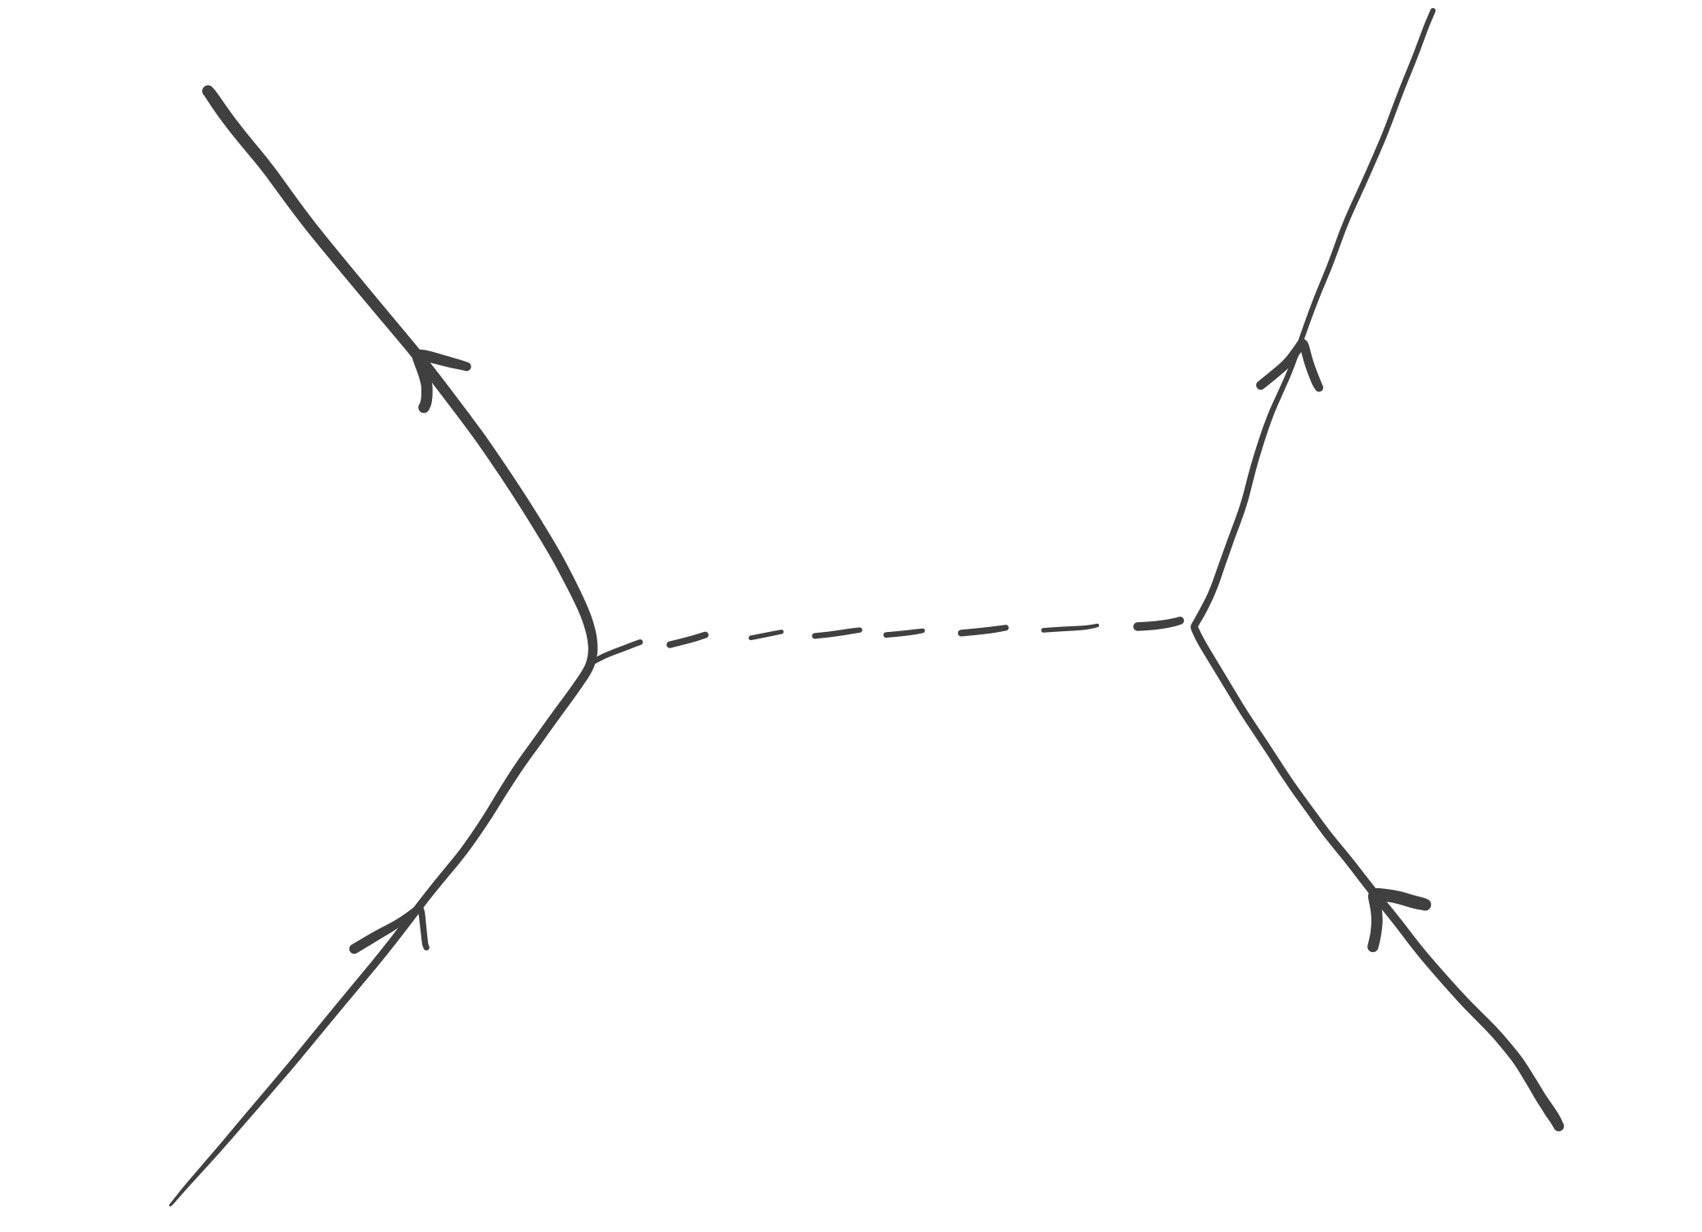
4. Feynman-Goldstone diagrams
Normal-ordered electronic Hamiltonian

Slide 32
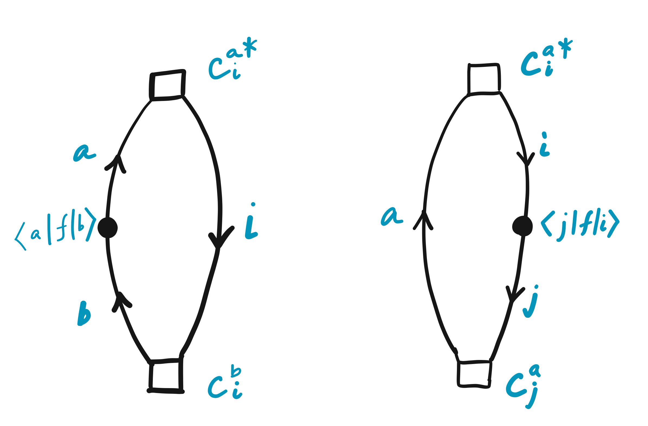
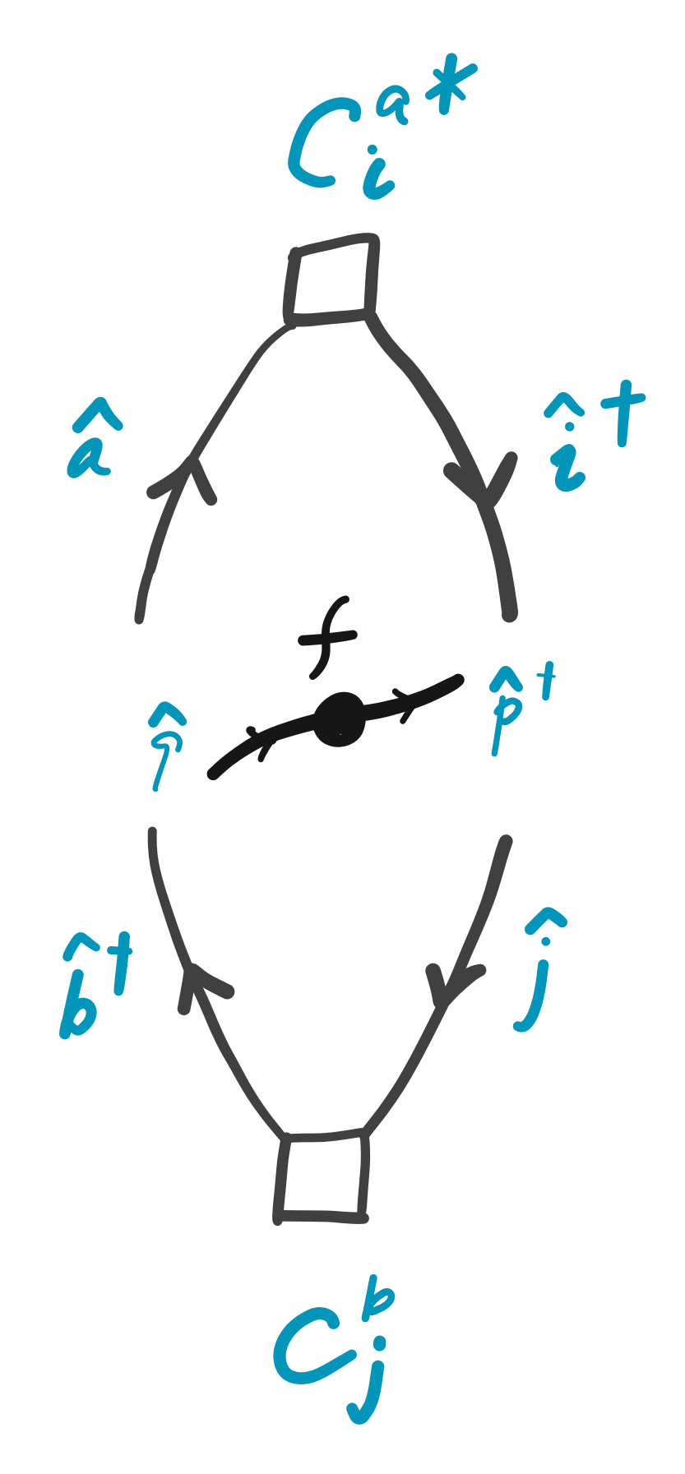
Case study: CIS

Slide 33
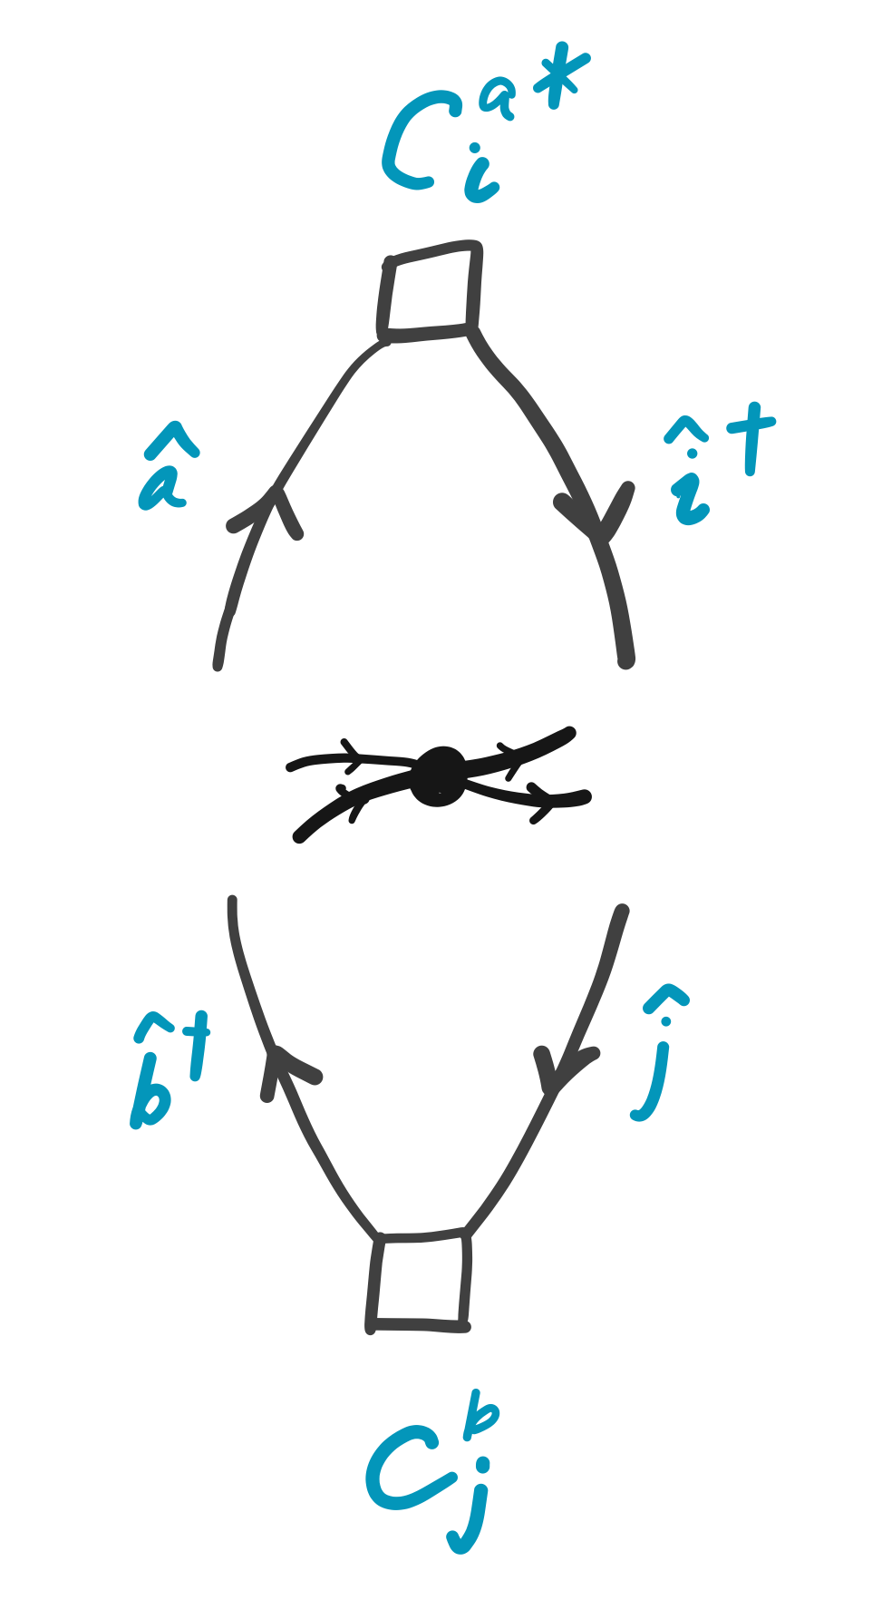
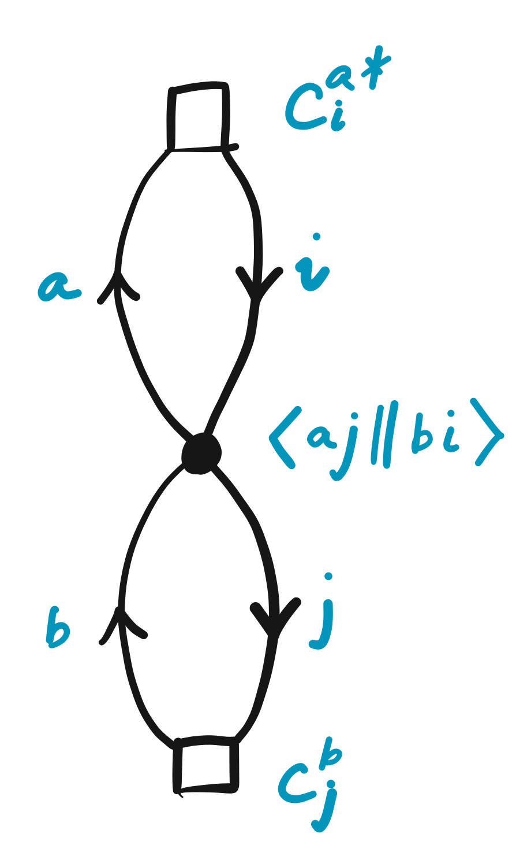
Case study: CIS

Slide 34

Case study: MP2
Partitioning of Hamiltonian

Slide 35
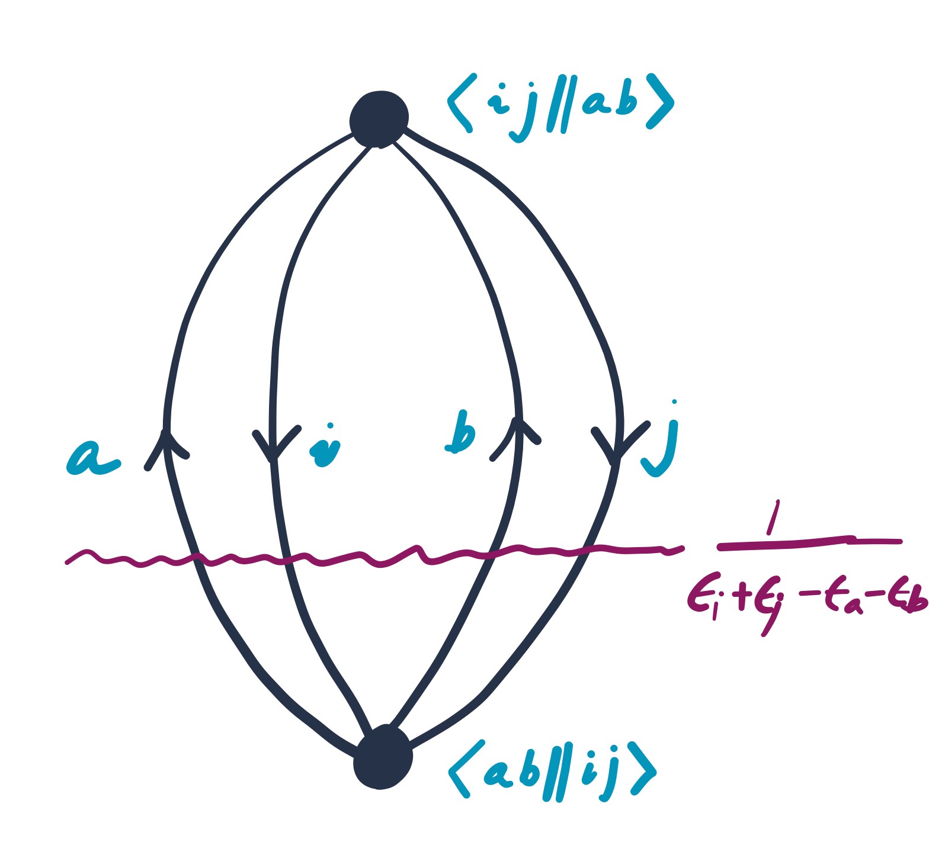
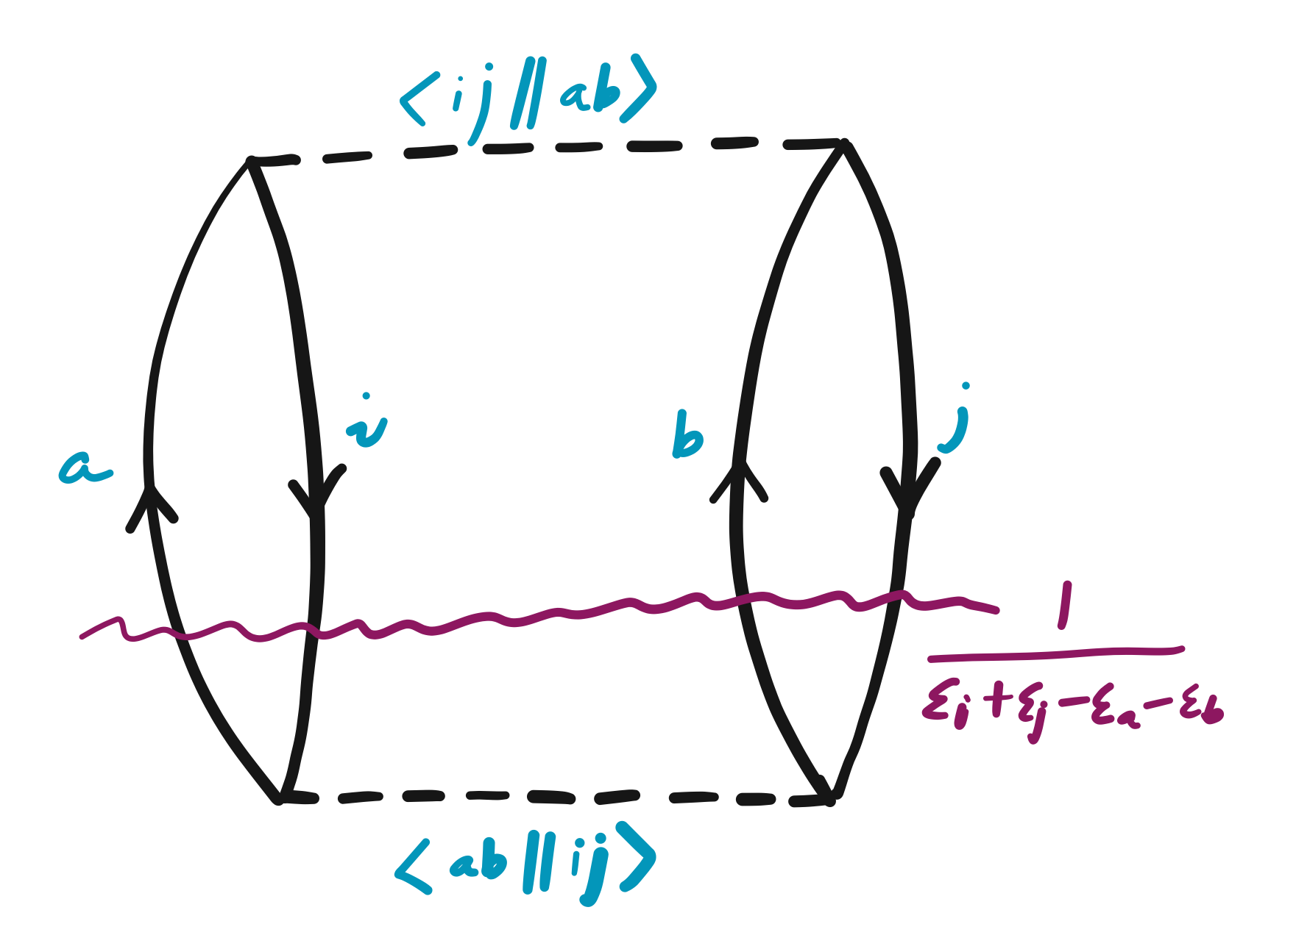
Chemists’ interpretation

Slide 36


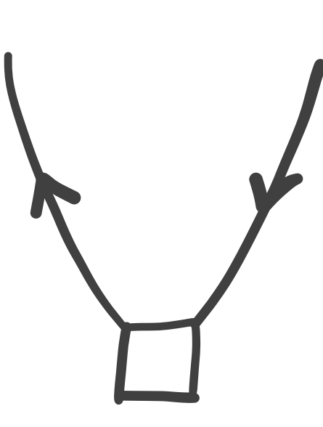
Chemists’ interpretation
Label with a hole (i, j, k) index and with a particle (a, b, c) index.
Associate vertex with ⟨out| f |in⟩.
Associate vertex with ⟨left-out, right-out||left-in, right-in⟩.
Associate excitation vertex with and de-excitation vertex with .
Sum over all internal line indexes.
Associate a factor of 1/2 for each pair of equivalent lines.
Associate 1/n! for n equivalent vertexes.
Multiply (–1)^{h+l} where h is the number of hole lines and l is the number of loops.

Slide 37
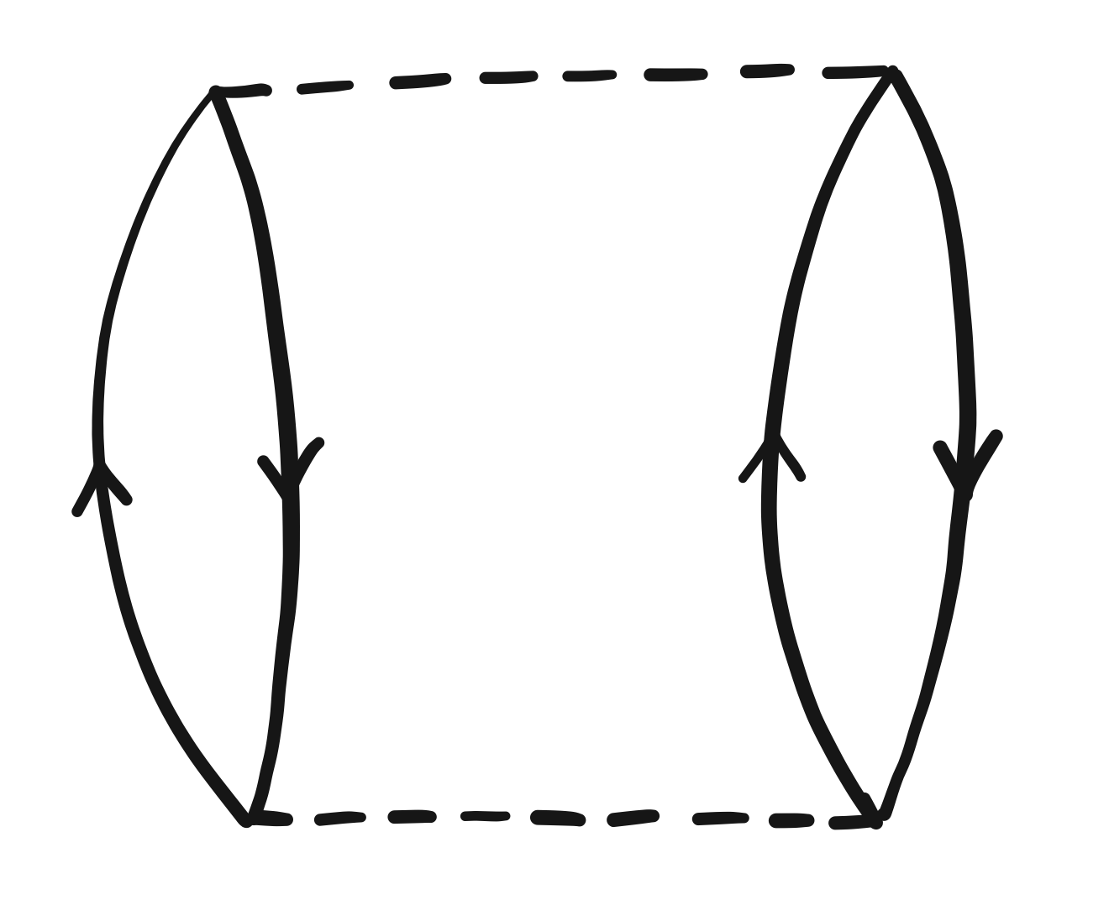
Physicists’ interpretation #1
Almlöf’s Laplace-transform MP2

Slide 38
Physicists’ interpretation #2

Slide 39
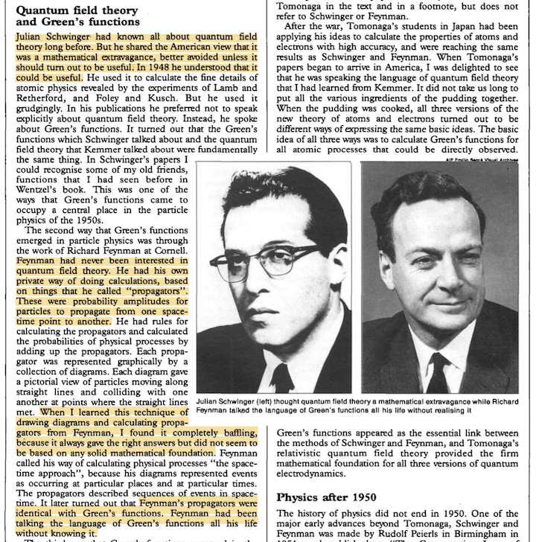
QFT, Green’s function, diagrams
F. Dyson, “George Green and physics”
Physics World (1993)
Freeman Dyson

Slide 40
Some mathematics
Fourier transform: freq to time
Fourier transform: time to freq
Laplace transform: imag time to freq

