Slide 1
Why is energy extensive?
So Hirata
Department of Chemistry

Slide 2
Extensivity
Energy is asymptotically proportional to volume
CCD (size consistent)
Linear
CID (not size consistent)
thermodynamic limit

Slide 3
Intensivity
Energy density is asymptotically constant with volume
CCD
Reaches a finite and nonzero value
CID
Slowly, steadily approaches zero
thermodynamic limit

Slide 4
Is energy extensive?

Slide 5
Is energy density intensive?

Slide 6
Gravitation and Coulomb
Threshold of intensivity
Energies of celestial bodies bound by gravitational forces or of like-charged particles bound by bare Coulomb forces are not extensive!
Statistical thermodynamics does not work for such systems!

Slide 7
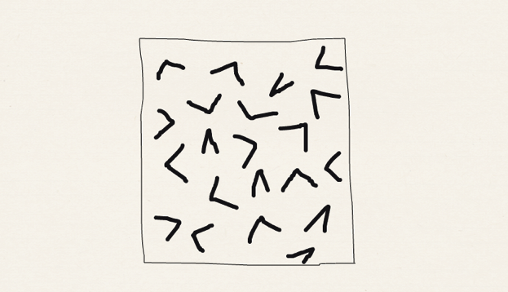
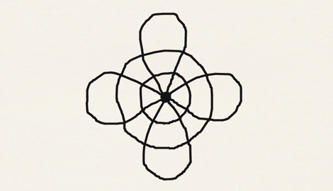
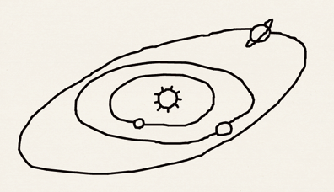
Validity of thermodynamics
Non-extensive
Extensive
Non-extensive
Size
Å
m
ly

Slide 8
Levin et al. Phys. Rep. 535, 1-60 (2014)
‘A long time ago Einstein expressed his belief that thermodynamics is “the only physical theory of universal content concerning which I am convinced that, within the framework of applicability of its basic concepts, it will never be overthrown.” One can, however, wonder about the extent of the “applicability” to which Einstein was referring. For example, can thermodynamics in any form be applied to study non-neutral plasmas or galaxies in which “particles” interact by long-range forces?’

Slide 9
Mathematicians’ proofs
Electrically neutral matter consisting of mobile electrons and nuclei
Lebowitz and Lieb, Phys. Rev. Lett. 22, 631 (1969).
Electrically neutral perfect crystals
Fefferman, Comm. Math. Phys. 98, 289 (1985).
Electrically neutral crystals with defects
Hainzl, Lewin, and Solovej, Adv. Math. 221, 454 & 488 (2009).

Slide 10
Chemist’s proof Hirata and Ohnishi, Phys. Chem. Chem. Phys. 14, 7800-7808 (2012)
We shall prove the extensivity of individual energy components for electrically neutral perfect crystals

Slide 11
Kinetic energy
Density
matrix
AO basis function
localized in cell m₂
Lattice sums over all cells in the volume
Energy per volume
Intensive

Slide 12
Coulomb energy
This is the sum of e-e repulsion, n-n repulsion, and e-n attraction
Double lattice sum
Charge
density
of cell m
Electron density of cell m
Nuclear density of cell m
Electrical neutrality

Slide 13
Coulomb energy
Energy per volume
Dipole-dipole interaction in the leading order
Single lattice sum
Unit cell dipole
Angular dependence
makes this 1/r³ lattice sum vanish
Intensive

Slide 14
Exchange energy
2-e integral
in chemists’ notation
Quadruple lattice sum
Density
matrix
2-e integral

Slide 15
Density matrix
Normalization
HF orbital
MO coefficient
Occupancy
Fourier
transform

Slide 16
Insulators
In an insulator, density matrix elements are strongly localized in a unit cell

Slide 17
Metals
In a metal, density matrix elements decay as 1/r²
Fermi
wave number
Spherical Bessel
Nonmetallic bands

Slide 18
Exchange energy
Even in a metal (let alone in an insulator), exchange energy remains intensive
1/r²
1/r
1/r²
Intensive

Slide 19
HF energy
Energy
Extensive
Fock integral
Intensive
momentum conservation
Two-electron integral
Inversely
extensive

Slide 20
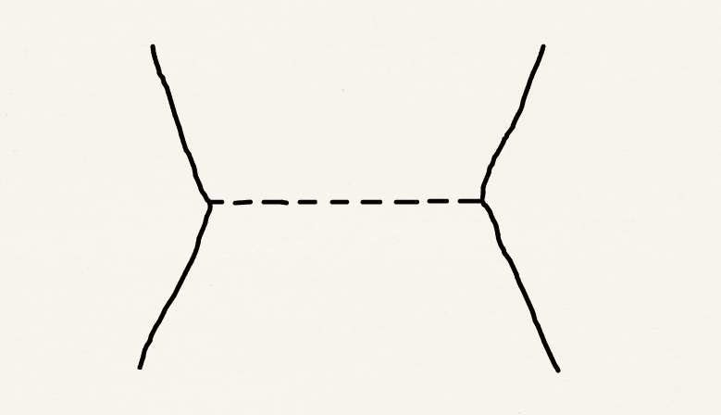
Inverse extensivity of 2e integrals
a
b
i
j

Slide 21
Evolution of the Hamiltonian
First quantized
Second quantized
Normal ordered
Diagrammatic
Extensive V¹
Intensive V⁰
Inversely extensive V⁻¹

Slide 22
Correlation energy: MP2
Extensive

Slide 23
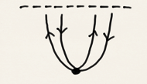
Correlation energy: MPn
According to Goldstone’s linked-diagram theorem
1
1
2
2
3
Extensive
n−1
n

Slide 24
Exact energy
This completes our proof of the extensivity of energy for electrically neutral perfect crystals
All extensive

