Slide 1
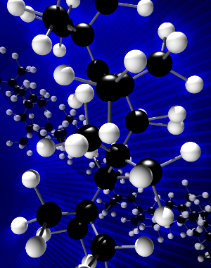
What NMR Can Do for You
by Lingyang Zhu
  Structure Elucidation of Small Molecules
    Structure identification of synthetic compounds, intermediates, impurities, mixtures, unknowns, regiochemistry, rotamerization
    Quantitative NMR
    Chemical exchange: Equilibrium or A(Di)ssociation constants
    Reaction monitoring or reaction rates
    Diffusion coefficients (DOSY NMR): monomer? dimer?
    Enantiomeric purity determination
    Absolute stereochemistry determination
    Dynamics (T₁, T₂ and NOE)
    Intramolecular hydrogen-bond determination
    Parahydrogen-NMR (enhance NMR signals thousands fold) to study reaction pathways
  NMR Screening (Protein-Ligand Interaction)
  Structure and Dynamics of Macromolecules and Complexes (e.g., peptides and proteins)
  Metabolites Analysis
NMR Lab Overview

Slide 2
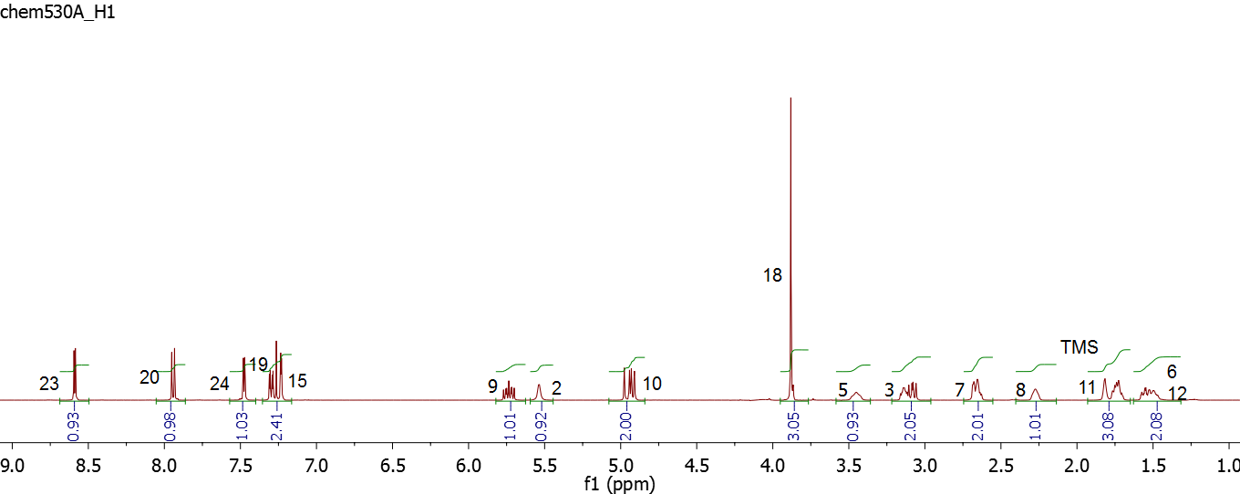
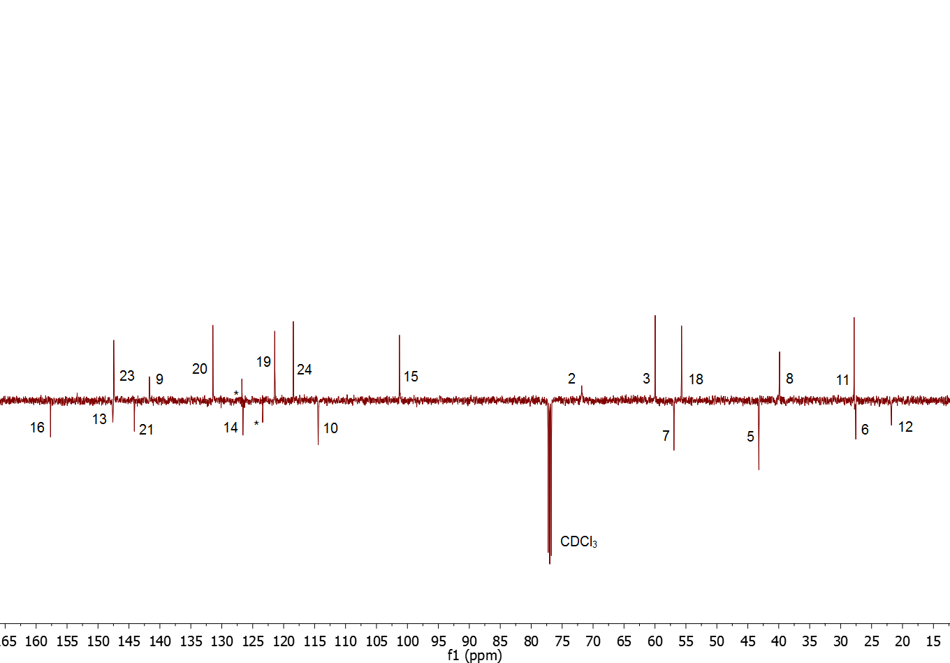
Count the Numbers
¹H Spectrum
Solution NMR in Organic Chemistry
Research Examples
¹³C-APT

Slide 3
Long-Range Connectivity:
¹H-¹³C gHMBC Spectrum
Solution NMR in Organic Chemistry
Research Examples

Slide 4
Relative Stereochemistry:
1D ¹H-¹H NOE Experiment
This problem can also be readily solved by ¹H-¹H
J-coupling constants
Solution NMR in Organic Chemistry
Research Examples

Slide 5
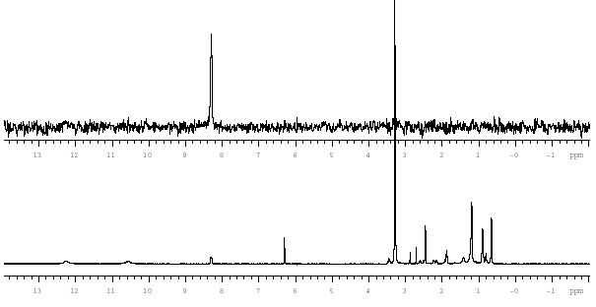
Regioisomer:
¹H-¹⁹F NOE Experiment
NOE seen between ¹⁹F and proton at position 3, but not to the pyrazole proton, suggesting the 5-position reaction, not 1-position.
Solution NMR in Organic Chemistry
Research Examples
NOE spectrum
3
¹H spectrum
3
6

Slide 6
Regioisomer:
¹⁵N Chemical Shifts
2
Based on the ¹⁵N chemical Shifts and
the connectivity from ¹H-¹⁵N HMBC spectrum
Solution NMR in Organic Chemistry
Research Examples
2
1
2
1

Slide 7
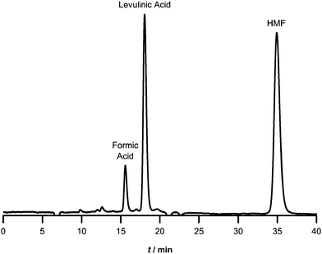
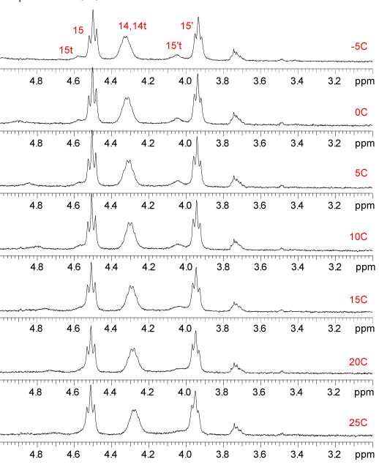
Variable Temperature Experiments:
Tautomer Identification
5°C
HPLC Data
Solution NMR in Organic Chemistry
Research Examples
25°C
HPLC Data

Slide 8
qNMR: Determination of %TFA
by an Internal Standard
Solution NMR in Organic Chemistry
Research Examples

Slide 9
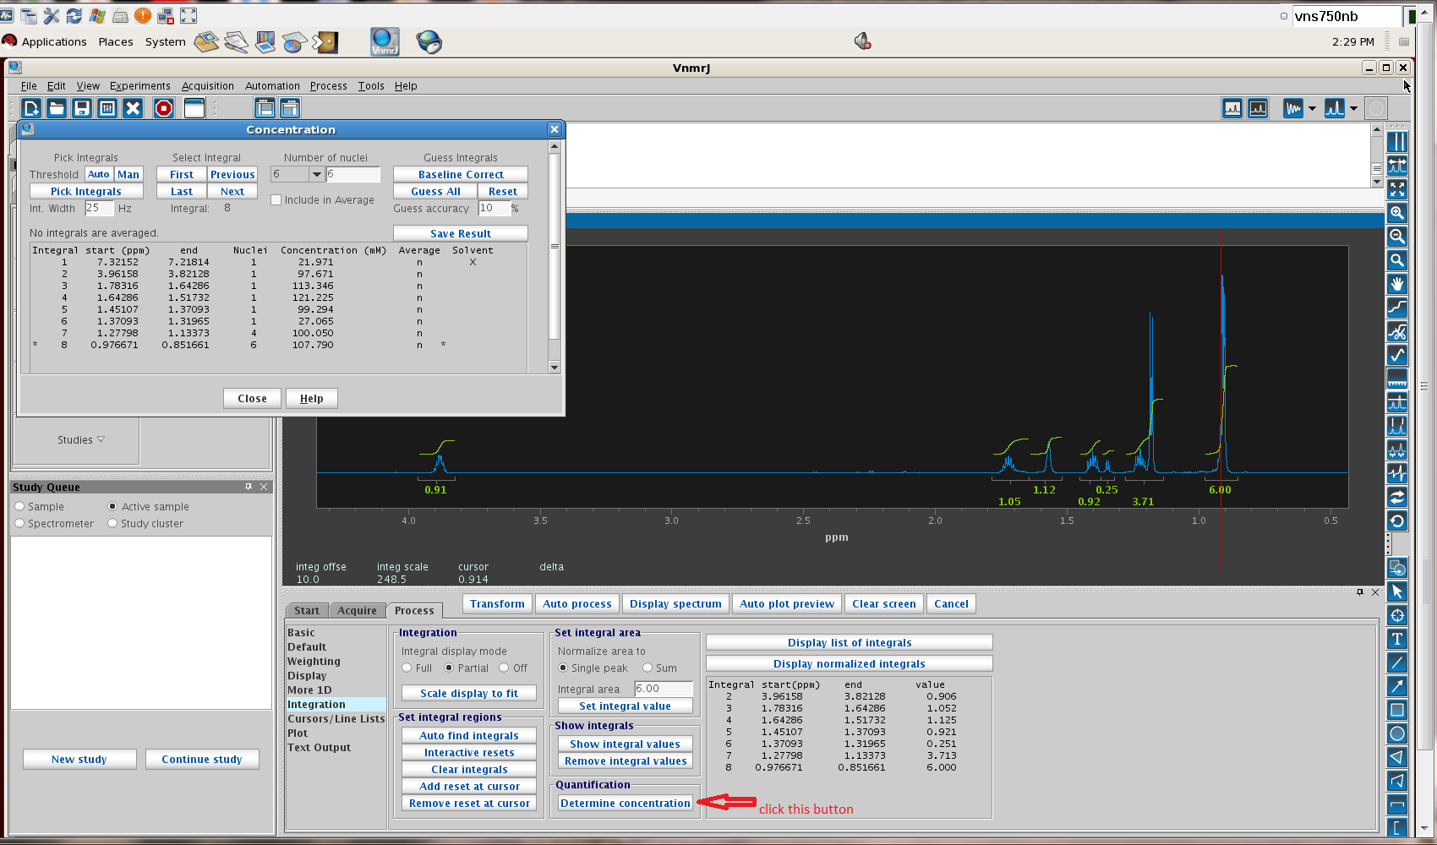
qNMR: Determining [sample]
using NMR software
Solution NMR in Organic Chemistry
Research Examples

Slide 10
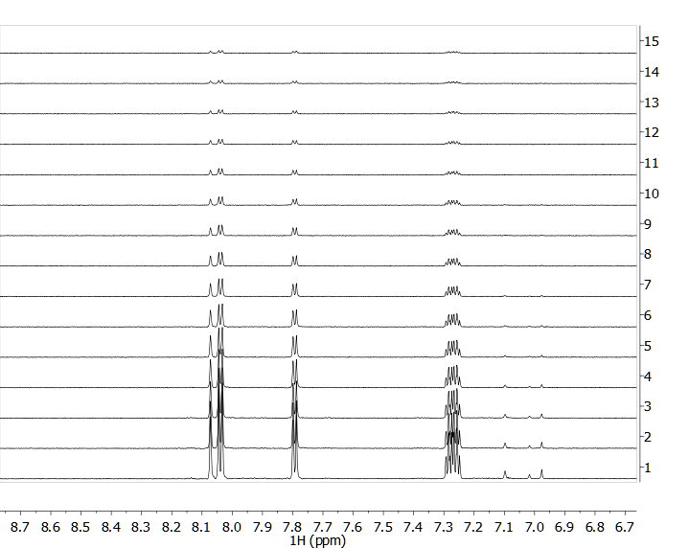
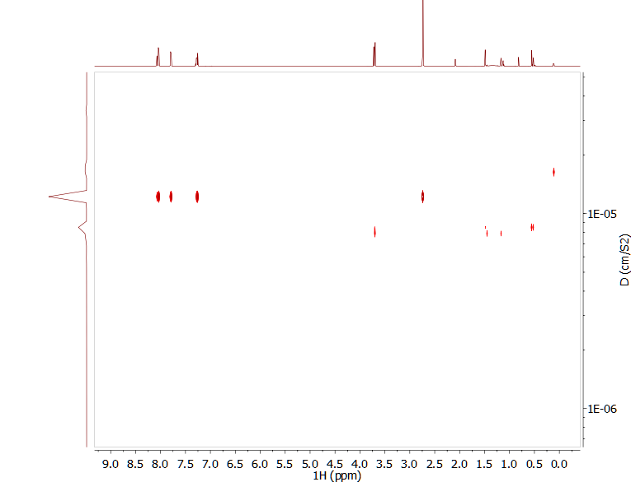
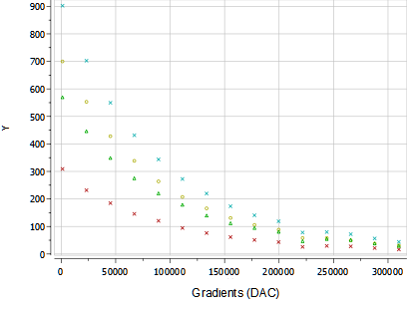

DOSY: Determination of MW / Mixture
M=(4r3N)/3
Solution NMR in Organic Chemistry
Research Examples

Slide 11
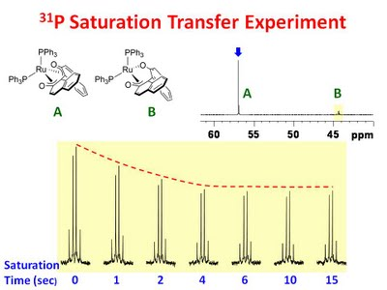
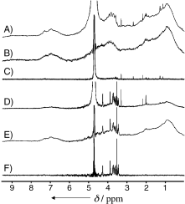
Chemical Exchange in NMR:
Intra- and Inter-molecular process
Intra-
k₁
k₋₁
K_{eq} determined by LW and Δδ
Solution NMR in Organic Chemistry
Research Examples
U. Ottawa NMR Facility
Inter-
k_{on}
+
k_{off}
K_{assoc} = k_{on}/k_{off}
STD Experiments
Meyer: 2003

Slide 12
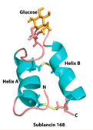
Collaborations & Publications
  Select Publications:
  Enzyme-mimetic, self-catalyzed polymerization of polypeptide helices. Nature Comm 2019 (Cheng group)
  Small on channels increase host defenses in cystic fibrosis airway epithelia. Nature 2019 (Burke group)
  Lithium-Olefin Pi Complexes and the Mechanism of Carbo-lithiation. Synthesis, Solution Behavior, and Crystal Structure of (2,2-Dimethylpent-4-en-1-yl. Organometallics, 2019 (Girolami group)
  Cobalt-Mediated ¹³C NMR signal Enhancement using Parahydrogen Induced Polarization. JACS 2018 (Fout group)
  A Metal-Free Electrocatalyst for Carbon Dioxide Reduction to Multi-Carbon Hydrocarbons and Oxygenates. Nature Comm 2016 (Kenis group)
  The interplay of Al and Mg speciation in advanced Mg battery electrolytes. JACS, 2015 (Gewirth group)
  Control of protein orientation on gold nanoparticles. JPC, 2015 (Murphy group)
  Structure, bioactivity, and resistance mechanism of streptomonomicin, an unusual lasso peptide from an understudied halophilic actnomycete. Chem Biol 2015 (Mitchell group)
  Alkyne Mechanochemistry: Putative Activation by Transoidal Bending. RSC ChemComm. 2014 (Moore group)
  NMR structure of the S-linked glycopeptide sublancin 168. ACS Chem Biol. 2014 (van der Donk group)
  New Reactions of Terminal Hydrides on a Diiron Dithiolate. JACS 2014 (Rauchfuss group)
NMR Lab Overview

Slide 13


Thank you
LU
Please visit us at http://scs.illinois.edu/nmr/
Questions Always Welcome
HuiHui, Xixi (crazy cat), and Lu (mellow cat)

