Slide 1
Low-temperature catastrophe of many-body perturbation theory for thermodynamics
So Hirata and Punit K. Jha
Department of Chemistry

Slide 2
Per-Olov Löwdin (1916–2000)
Ab initio calculations of ionic crystals.
Löwdin orthogonalization.
Definition of correlation energy.
Reduced density matrices and natural orbitals.
Löwdin partitioning and perturbation theory.
EHF, PHF, and GHF; Symmetry dilemma.
IJQC; AQC; IAQMS; ICQC.
Advisory Board, Institute for Molecular Science.
Quantum Theory Project; Sanibel Symposia.
Notes:
It is a great honor and in fact an overwhelming honor to be a Lowdin lecturer, especially, for me as I worked for 9 years in Quantum Theory Project at University of Florida, which Per-Olov Lowdin founded.
I met Dr. Lowdin twice. In the first time, I was a graduate student at IMS in Japan, attending a Sanibel Symposium, which Per-Olov started. In the second time, I was a postdoc of Rod Bartlett at QTP, who was Lowdin’s student and introduced me to Dr. Lowdin also at Sanibel Symposium.
What I remember from those brief encounters is great respect he commanded from everyone attending the Symposia – so he was a celebrity and a beloved figure in our field. I also remember a very broad smile or grin on his lips and his intense, telepathic stare he gave me, when Rod introduced me to him. Also, when he came across a grand piano in the hotel venue, he spontaneously started playing a very jovial folk music, in front of a mesmerized international audience. So, Lowdin emanated a mythic level of charisma, attached only to a man who founded a field, which is our field, and also many institutions central to our field.
It’s certainly impossible to escape the influence of Lowdin’s in this field. Rather, I find it more instructive and interesting to try to fathom his intuitions from his many achievements. Perhaps, Dr. Lowdin is best known for density matrices and natural orbitals, but he seems most obsessed with perturbation theory, writing as many as 14 papers entitled “studies in perturbation theory”. I see the same obsession in Rod Bartlett, Lowdin’s student and my mentor, and now in myself as well. I am most thrilled to learn that Lowdin’s Ph.D. work was on ab initio calculations of solids because mine was also.

Slide 3
Contents
Charge neutrality and extensivity of energy
Is textbook finite-temperature MBPT correct?
Correct analytical formulas at 1st and 2nd orders
The Kohn–Luttinger conundrum redux:
Low-temperature catastrophe of finite-temperature MBPT

Slide 4

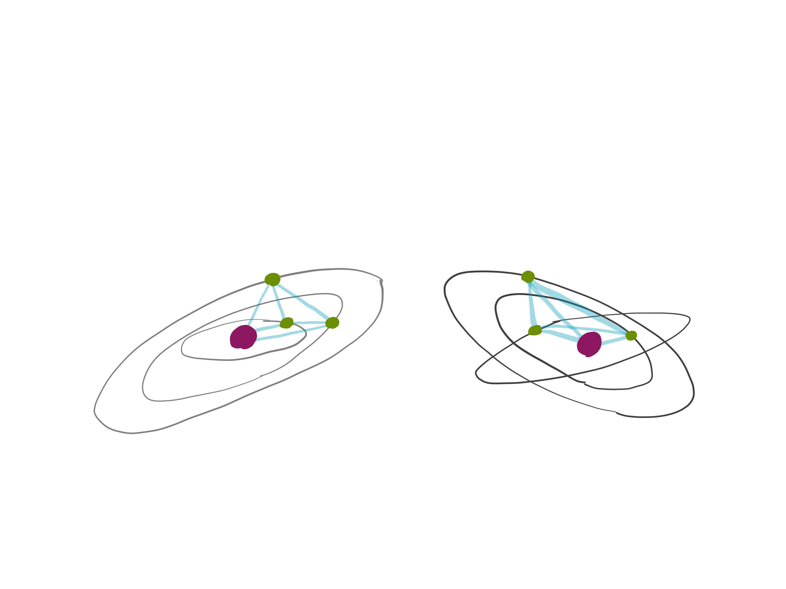
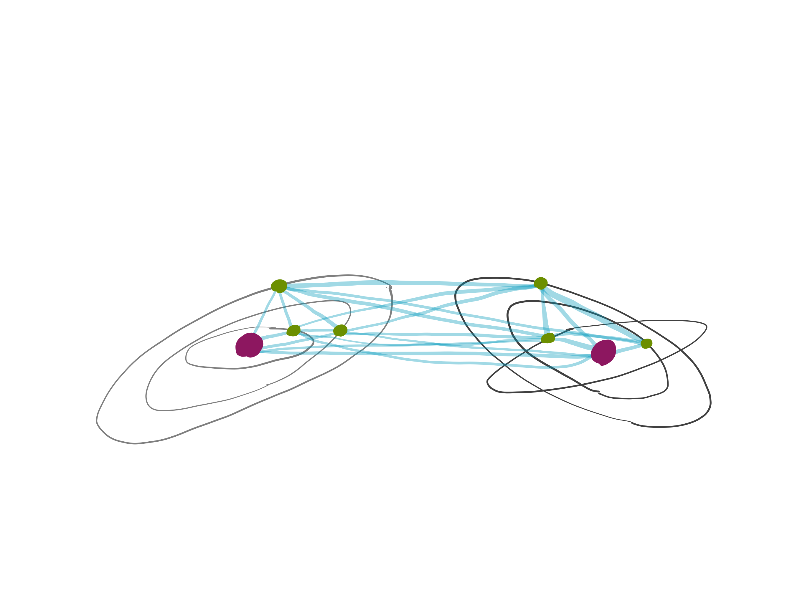

Charge neutrality and extensivity of energy
Chemical system
A
B
Energy is extensive
Thermodynamics works
Gravitational system
Charged plasma
A
B
Energy is non-extensive
Thermodynamics breaks down

Slide 5

Is textbook finite-temperature MBPT correct?
Punit K. Jha & So Hirata
Department of Chemistry
Punit K. Jha
2019 IBM-Löwdin Awardee

Slide 6
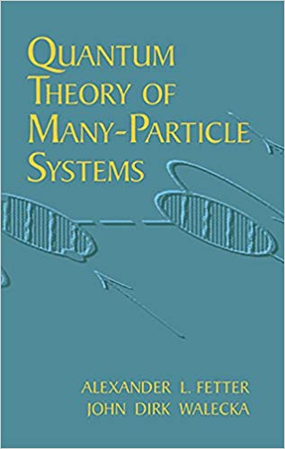

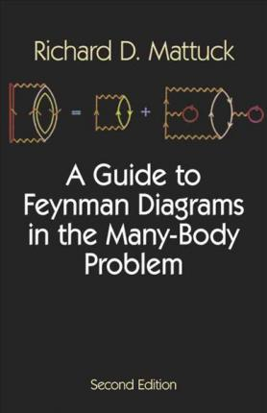
Finite-temperature MBPT

Slide 7
Grand canonical ensemble
Grand partition function
Average number of electrons
Chemical potential
Neutrality condition
Grand potential
Bloch equation
Internal energy
Schrödinger equation

Slide 8
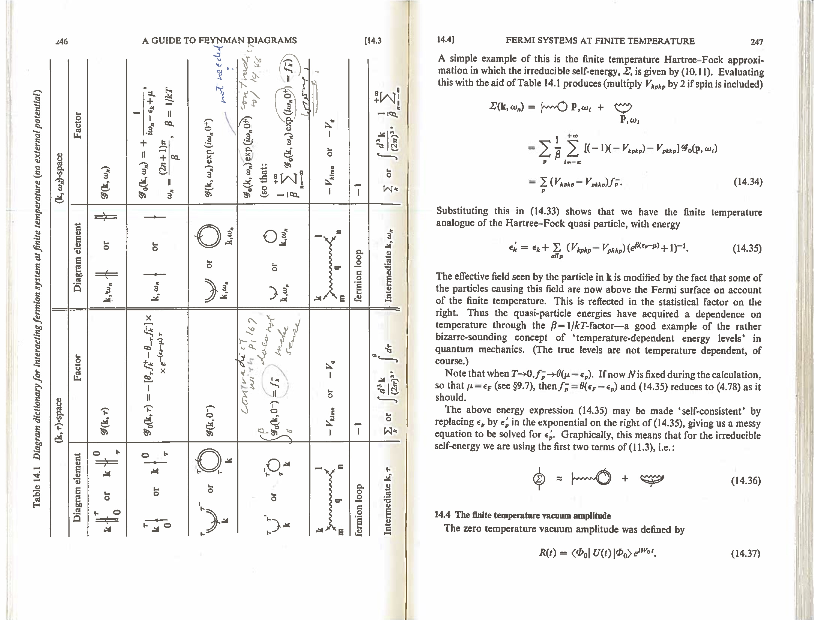
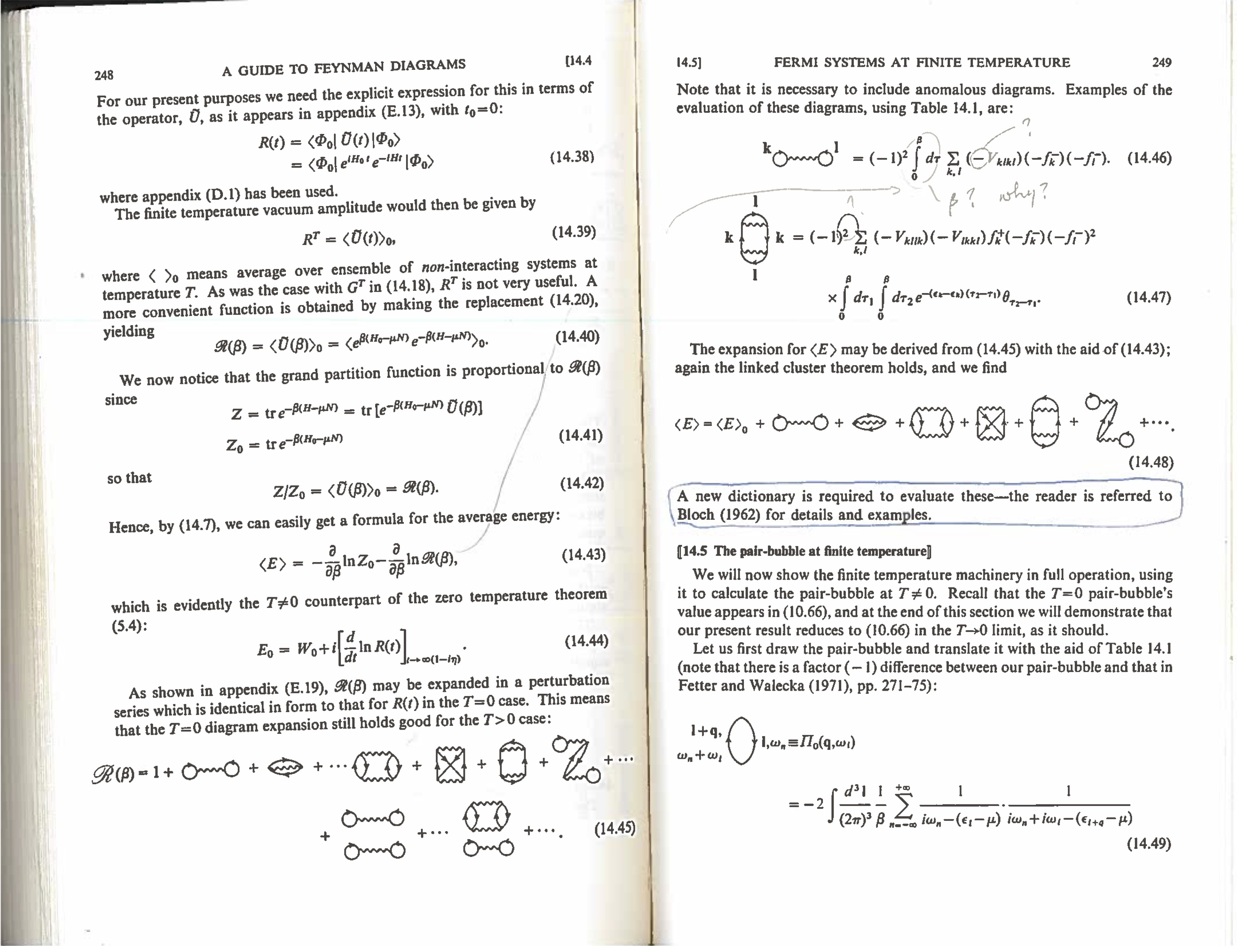
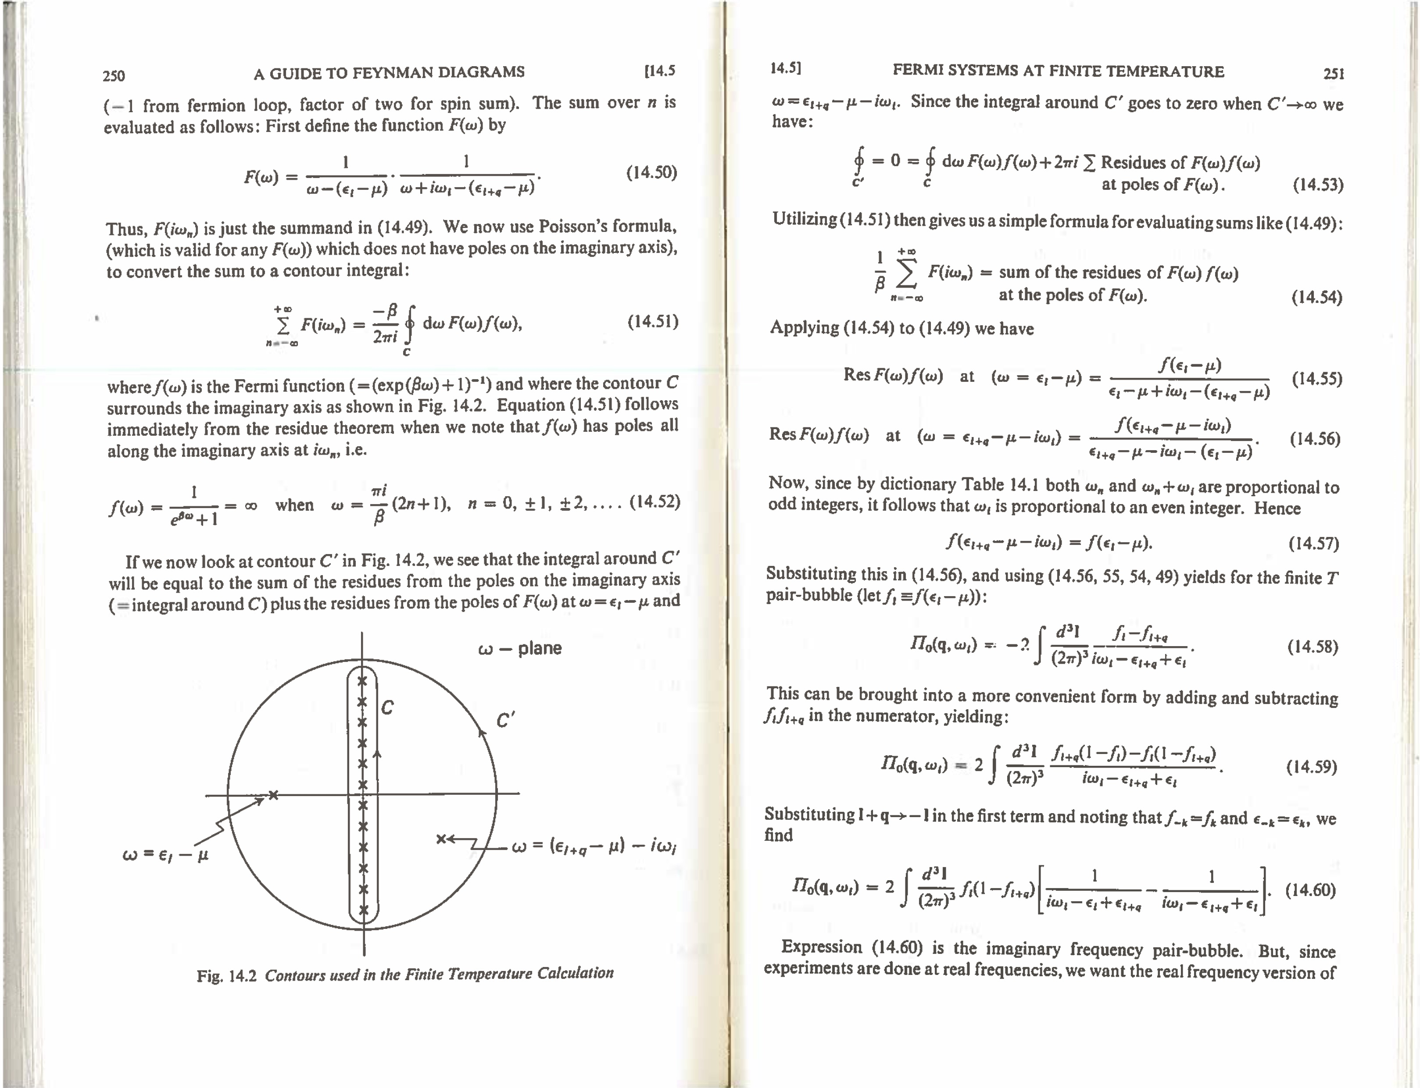
Time-dependent diagrammatic derivation using Matsubara Green’s function or thermal Wick’s theorem

Slide 9
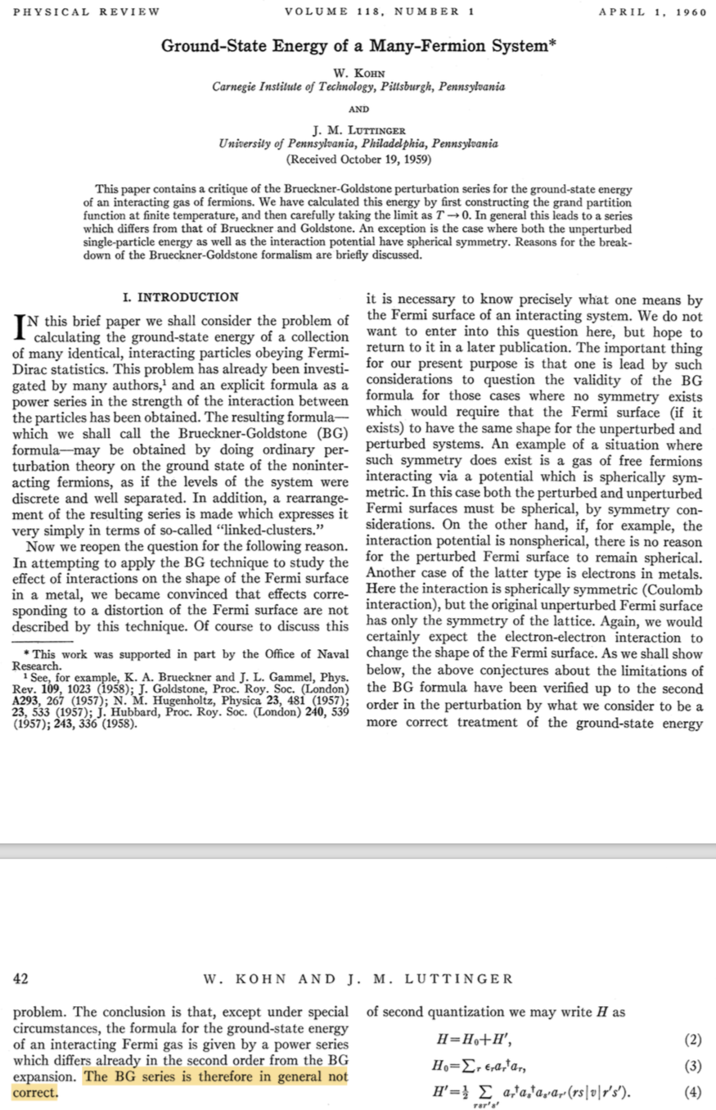
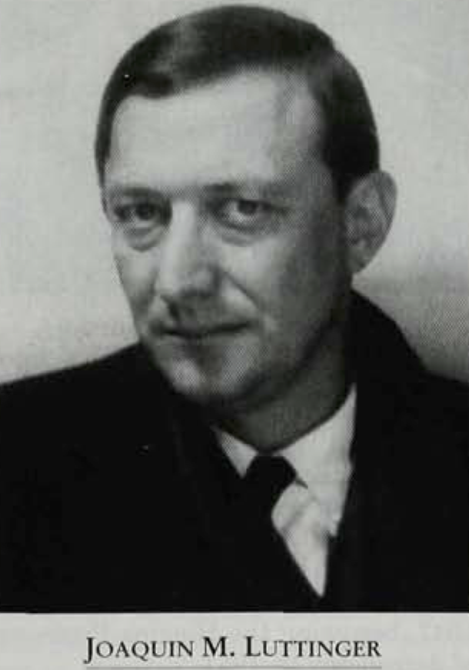

In nonisotropic degenerate systems

Slide 10
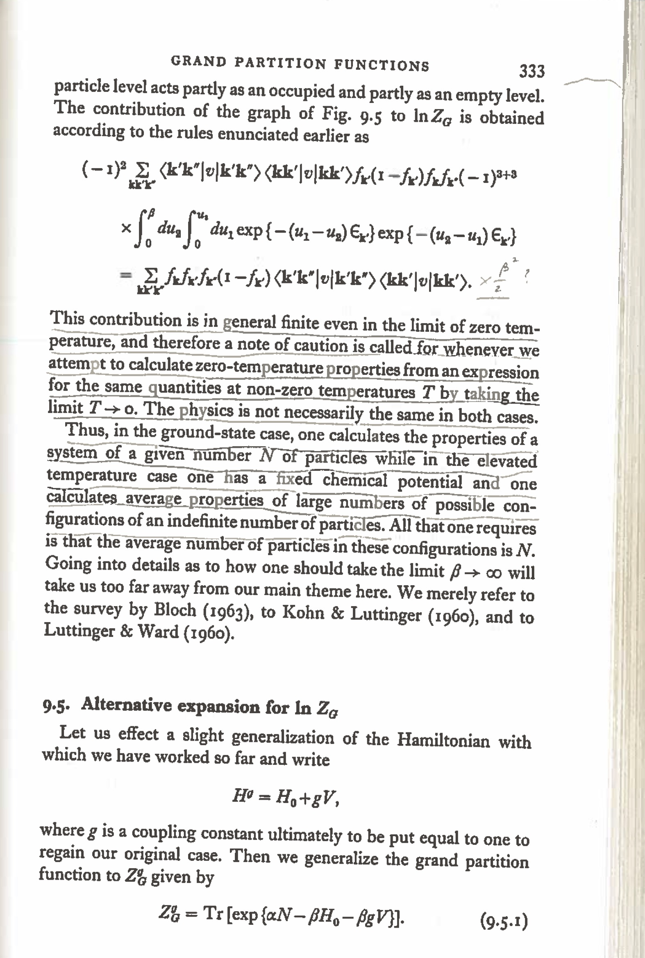
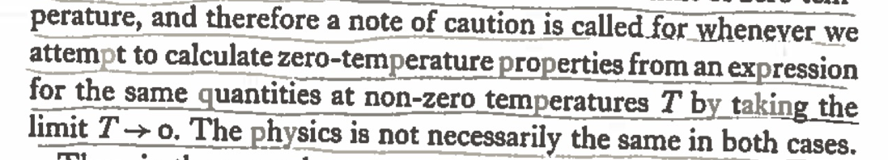

Slide 11
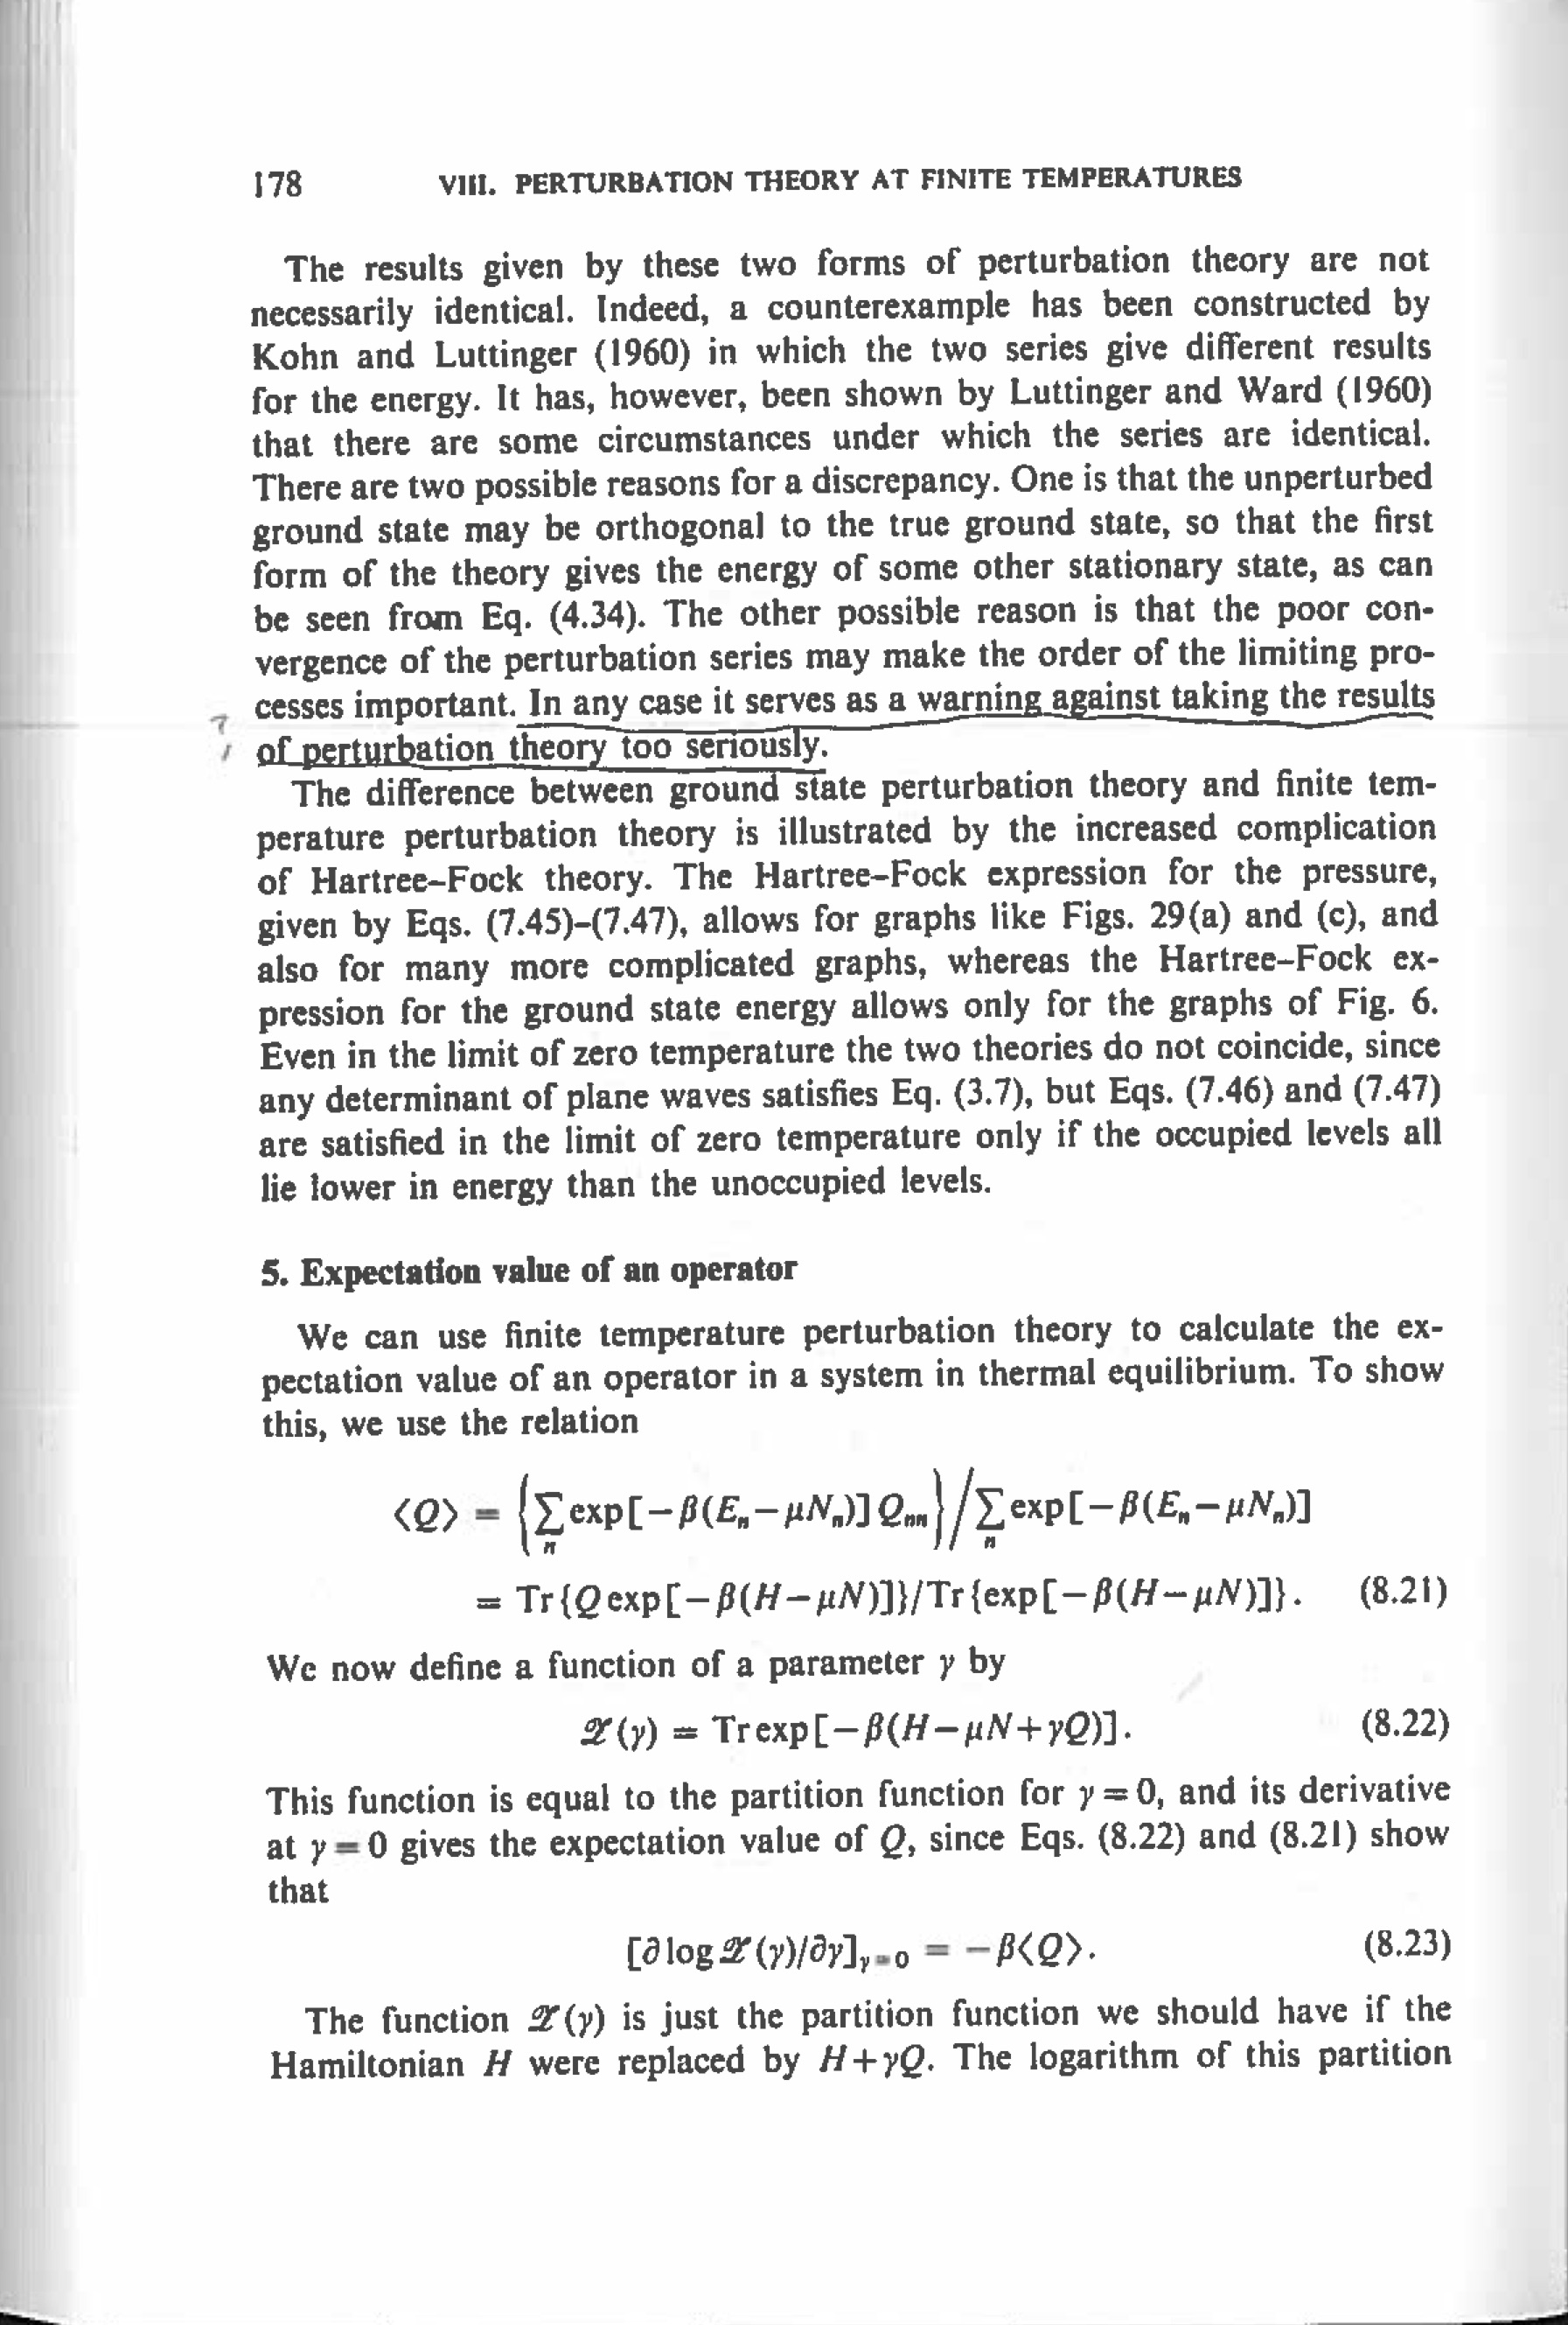
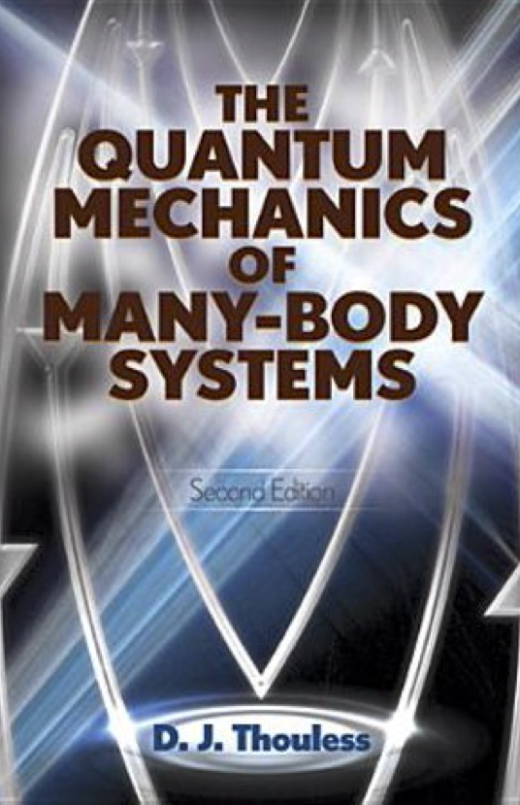
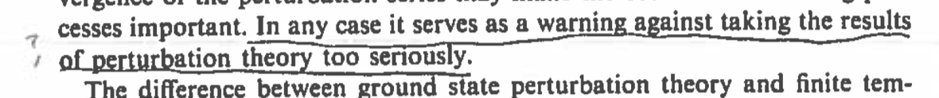

Slide 12
Core definition of perturbation theory
FCI with perturbation-scaled Hamiltonian
nth-order correction

Slide 13
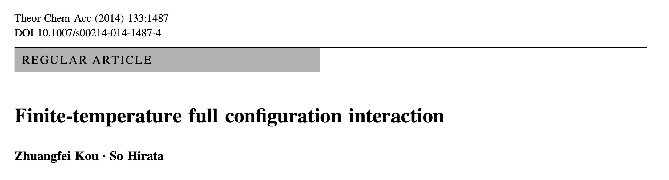
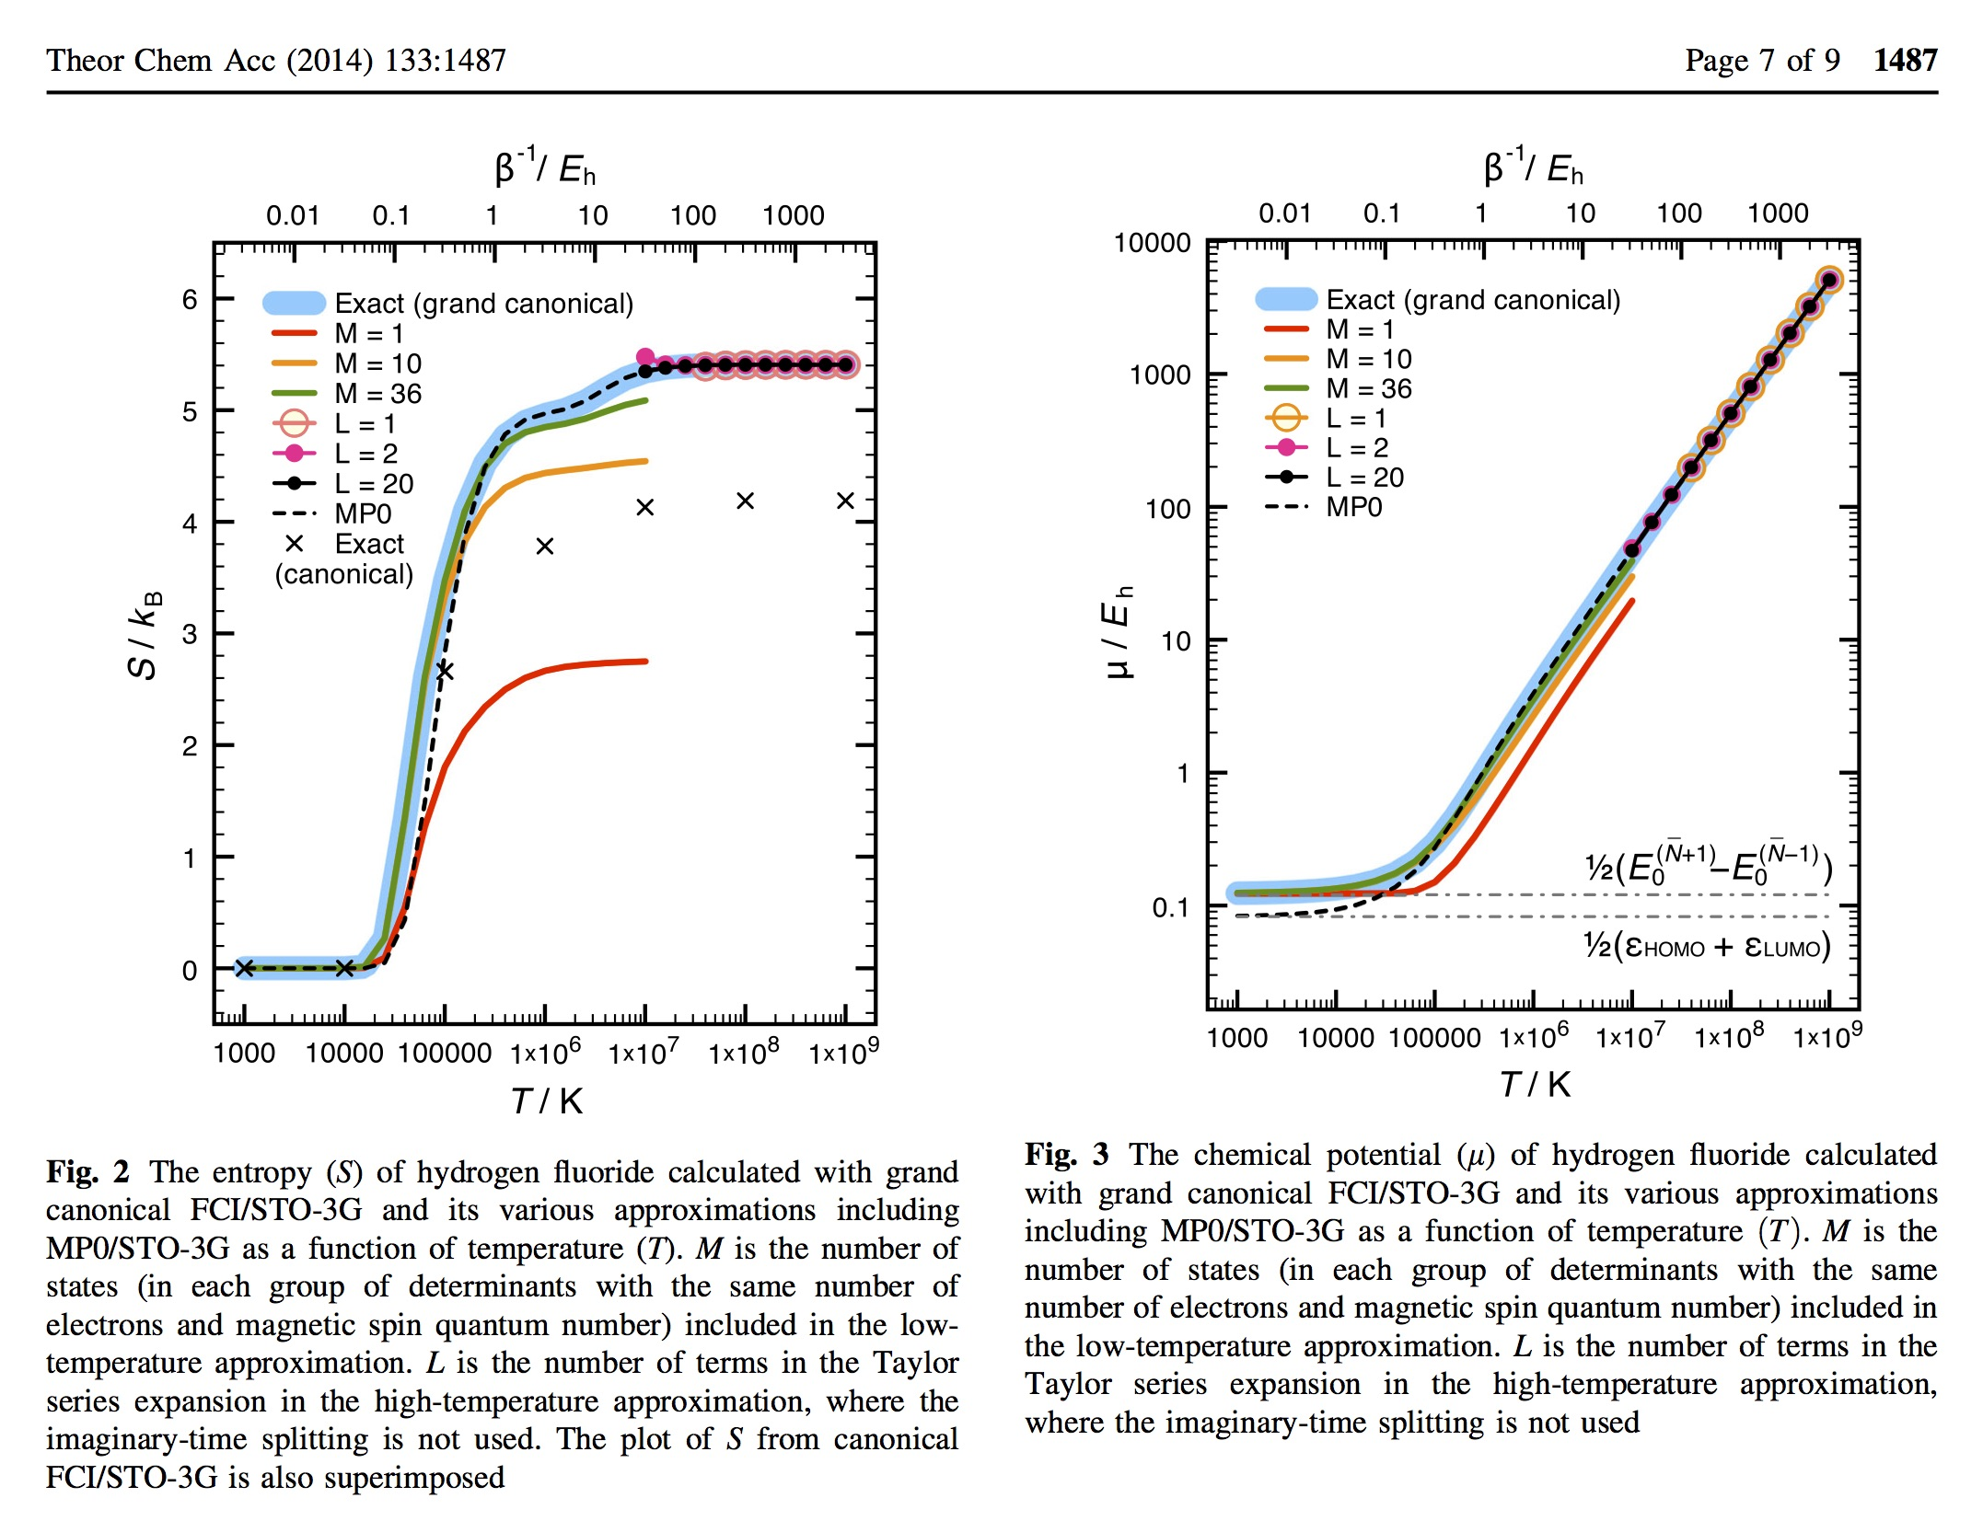
Neutrality condition

Slide 14
λ-variation benchmark
Grand partition function
nth-order correction
Chemical potential
Grand potential
Internal energy

Slide 15
Zeroth order (Fermi–Dirac theory)
Jha and Hirata, Annu. Rep. Comput. Chem. (2019)
 | Ω ⁽⁰⁾ / E_{h} |  | U ⁽⁰⁾ / E_{h}
T / K | Textbook | Benchmark | Textbook | Benchmark
10³ | −53.41122 | −53.41122 | −52.57490 | −52.57490
10⁴ | −53.51172 | −53.51172 | −52.57490 | −52.57490
10⁵ | −55.63653 | −55.63653 | −52.01660 | −52.01660
10⁶ | −105.9471 | −105.9471 | −50.59635 | −50.59635
10⁷ | −686.7029 | −686.7029 | −45.78913 | −45.78913
10⁸ | −6804.938 | −6804.938 | −42.36405 | −42.36405
10⁹ | −68084.45 | −68084.45 | −41.94527 | −41.94527
Textbook formulas
is determined by
Neutrality condition
Textbook formulas for Ω⁽⁰⁾ and U⁽⁰⁾ are correct.

Slide 16
First order
Jha and Hirata, Annu. Rep. Comput. Chem. (2019)
 | Ω ⁽¹⁾ / E_{h} |  | U ⁽¹⁾ / E_{h}
T / K | Textbook | Benchmark | Textbook | Benchmark
10³ | −45.99586 | −45.99586 | ? | −45.99586
10⁴ | −45.99586 | −45.99586 | ? | −45.99586
10⁵ | −46.02318 | −45.26843 | ? | −45.94786
10⁶ | −46.21519 | −44.52564 | ? | −46.17665
10⁷ | −46.18020 | −43.19912 | ? | −46.23554
10⁸ | −46.10675 | −41.98466 | ? | −46.11803
10⁹ | −46.09261 | −41.82639 | ? | −46.09746
Textbook formulas
does not appear
Textbook formula for Ω⁽¹⁾ is incorrect; U⁽¹⁾ and μ⁽¹⁾ are unknown.

Slide 17
Second order
Jha and Hirata, Annu. Rep. Comput. Chem. (2019)
 | Ω ⁽²⁾ / E_{h} |  | U ⁽²⁾ / E_{h}
T / K | Textbook | Benchmark | Textbook | Benchmark
10³ | −0.017336 | −0.435343 | ? | −0.017336
10⁴ | −0.017336 | −0.432438 | ? | −0.017336
10⁵ | −0.268946 | −2.581461 | ? | +0.098420
10⁶ | −0.120554 | −0.964319 | ? | −0.219843
10⁷ | −0.021838 | −0.196966 | ? | −0.032596
10⁸ | −0.003181 | −0.027593 | ? | −0.005358
10⁹ | −0.000331 | −0.002848 | ? | −0.000566
Textbook formulas
does not appear
Textbook formula for Ω⁽²⁾ is incorrect; U⁽²⁾ and μ⁽²⁾ are unknown.

Slide 18
What is wrong with textbook formulas?
Beyond zeroth order, textbook theory disagrees with the benchmarks.
White & Chan (arXiv) showed that the textbook theory reproduces the benchmarks if and only if μ is held fixed in both cases.
The textbook theory is wrong not so much mathematically as physically since it does not vary μ with perturbation order to keep the system neutral; instead it allows the average number of electrons to fluctuate, making the system massively charged. In such a charged plasma, energy is non-extensive ( ) and chemical thermodynamics no longer holds.
Put another way, the textbook perturbation theory does not converge at the exact limit unless exact (FCI) μ is known in advance.

Slide 19
Correct analytical formulas at the first and second orders
So Hirata & Punit K. Jha
Department of Chemistry

Slide 20
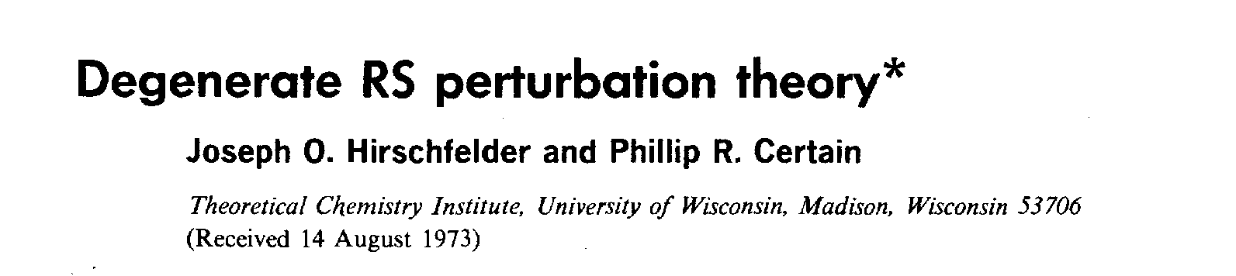
Sum-over-states 1st-order formulas
Hirata and Jha, Annu. Rep. Comput. Chem. (2019); Jha and Hirata, Phys. Rev. E (2020)
Analytically differentiate the FCI definitions
Neutrality condition
Identify as the nth-order
Hirschfelder–Certain
degenerate perturbation energy

Slide 21
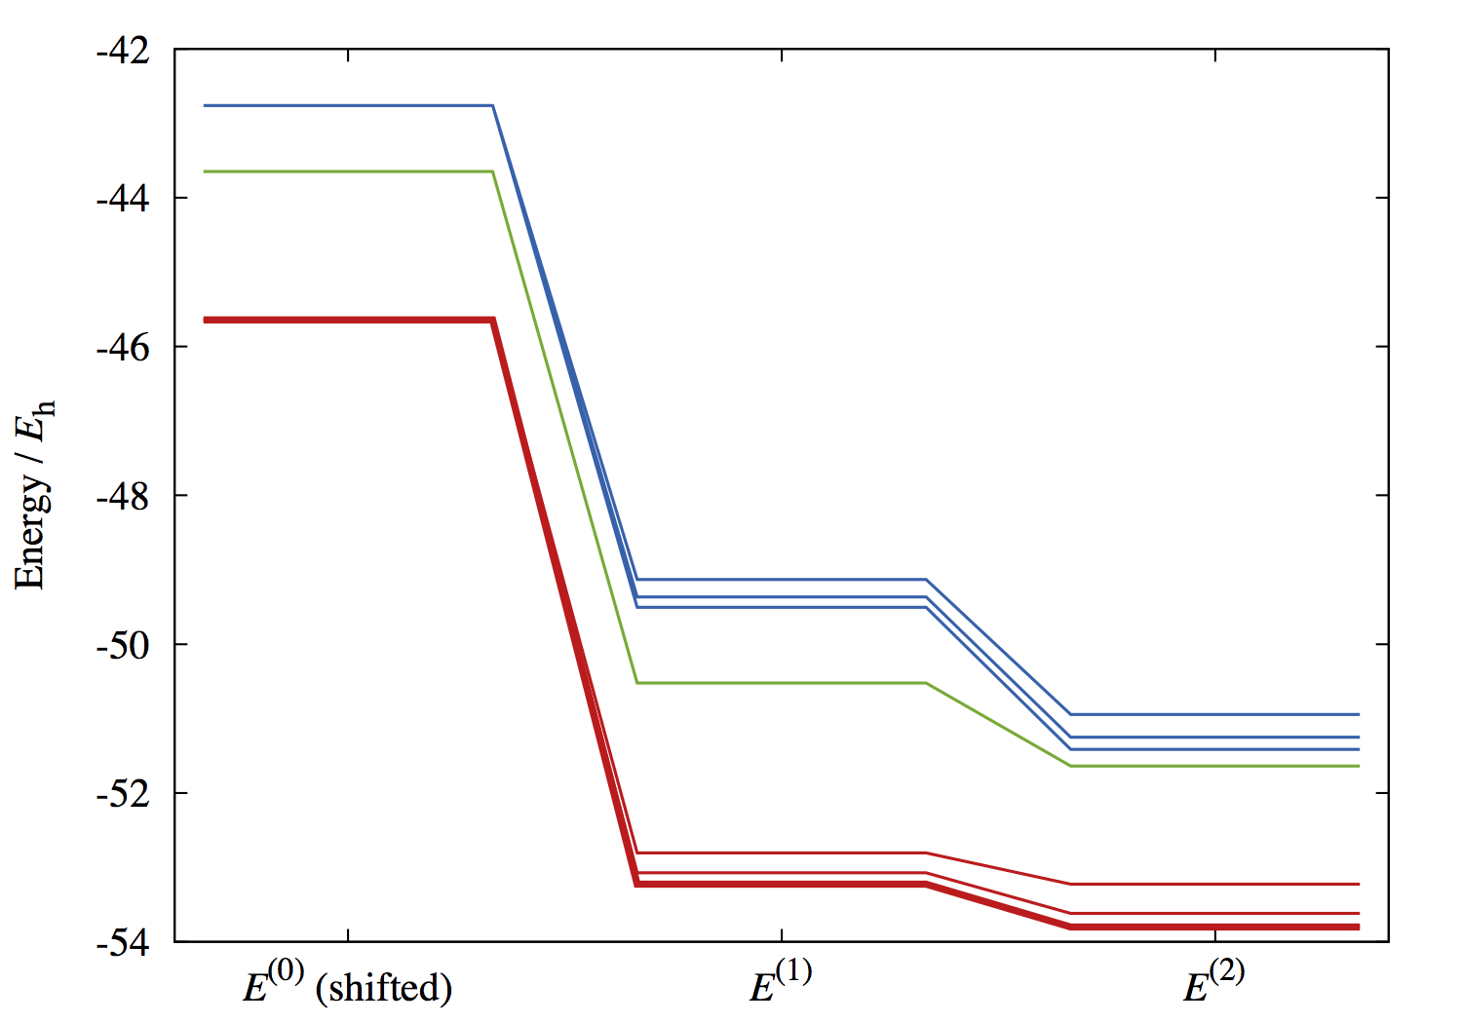
Sum rules
Hirschfelder and Certain, J. Chem. Phys. (1974); Hirata and Jha, J Chem. Phys. (2020)
They are summed with the equal Boltzmann weight
Slater-Condon rules & trace invariance

Slide 22
Boltzmann identities
Hirata and Jha, Annu. Rep. Comput. Chem. (2019)
Sum-over-states analytical formula
Use Boltzmann identities such as
Reduced (molecular-integral) analytical formula

Slide 23
Reduced 1st-order formulas
Hirata and Jha, Annu. Rep. Comput. Chem. (2019)
Textbook formulas
New formulas

Slide 24
First order
Hirata and Jha, Annu. Rep. Comput. Chem. (2019)
 | Ω ⁽¹⁾ / E_{h} |  |  | μ ⁽¹⁾ / E_{h} |  |  | U ⁽¹⁾ / E_{h}
T / K | Textbook | New | Benchmark | Textbook | New | Benchmark | Textbook | New | Benchmark
10⁴ | −45.9959 | −45.9959 | −45.9959 | 0 | +0.0000 | +0.0000 | ? | −45.9957 | −45.9959
10⁵ | −46.0232 | −45.2684 | −45.2684 | 0 | −0.0752 | −0.0752 | ? | −45.9479 | −45.9479
10⁶ | −46.2152 | −44.5256 | −44.5256 | 0 | −0.1690 | −0.1690 | ? | −46.1767 | −46.1767
10⁷ | −46.1802 | −43.1991 | −43.1991 | 0 | −0.2981 | −0.2981 | ? | −46.2355 | −46.2355
10⁸ | −46.1068 | −41.9847 | −41.9847 | 0 | −0.4122 | −0.4122 | ? | −46.1180 | −46.1180
New (both SoS & reduced) formulas reproduce the benchmark.

Slide 25
Sum-over-states 2nd-order formulas
Hirata and Jha, J. Chem. Phys. (2020)
Analytically differentiate the FCI definitions

Slide 26
Sum rules
Hirschfelder and Certain, J. Chem. Phys. (1974); Hirata and Jha, J Chem. Phys. (2020)

Slide 27
Boltzmann identities
Hirata and Jha, J. Chem. Phys. (2020)
Sum-over-states analytical formula
Use Boltzmann identities such as
exclude index coincidence
exclude index coincidence
Reduced (molecular-integral) analytical formula

Slide 28
Reduced 2nd-order formulas
Hirata and Jha, J. Chem. Phys. (2020)
Textbook formulas
New formulas

Slide 29
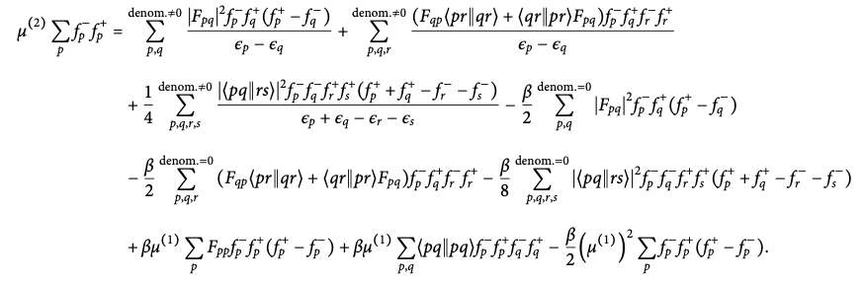
Reduced 2nd-order formulas
Hirata and Jha, J. Chem. Phys. (2020)
Textbook formulas
New formulas

Slide 30
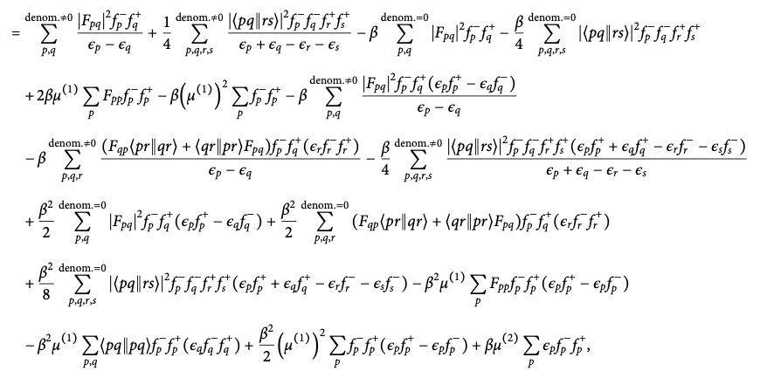
Reduced 2nd-order formulas
Hirata and Jha, J. Chem. Phys. (2020)
Textbook formulas
New formulas

Slide 31
Second order
Hirata and Jha, J. Chem. Phys. (2020)
 | Ω ⁽²⁾ / E_{h} |  |  | μ ⁽²⁾ / E_{h} |  |  | U ⁽²⁾ / E_{h}
T / K | Textbook | New | Benchmark | Textbook | New | Benchmark | Textbook | New | Benchmark
10⁴ | −0.0173 | −0.4324 | −0.4324 | 0 | 0.0415 | 0.0415 | ? | −0.0173 | −0.0173
10⁵ | −0.2689 | −2.5814 | −2.5814 | 0 | 0.2320 | 0.2320 | ? | 0.0984 | 0.0984
10⁶ | −0.1206 | −0.9643 | −0.9643 | 0 | 0.0851 | 0.0851 | ? | −0.2198 | −0.2198
10⁷ | −0.0218 | −0.1970 | −0.1970 | 0 | 0.0177 | 0.0178 | ? | −0.0326 | −0.0326
10⁸ | −0.0032 | −0.0276 | −0.0276 | 0 | 0.0025 | 0.0025 | ? | −0.0054 | −0.0054
New (both SoS & reduced) formulas reproduce the benchmark.

Slide 32
The Kohn–Luttinger conundrum redux
Low-temperature catastrophe of finite-temperature MBPT
So Hirata
Department of Chemistry

Slide 33
?

Slide 34
Low-temperature catastrophe
Hirata, submitted (2020)
For degenerate ground state,
Square-planar
degenerate H₄

Slide 35
Case study #1: degenerate ref
Hirata, submitted (2020)
A prime example of a nonanalytic function at T=0, which is infinitely differentiable yet cannot be expanded in a power series
Reference is degenerate

Slide 36
Case study #2: incorrect ref
Hirata, submitted (2020)
Ref is actually an excited state in fully interacting limit

Slide 37
Case study #3: nondegenerate ref
Hirata, submitted (2020)

Slide 38
Conclusion
Finite-temperature perturbation theory that expands Ω, U, μ on an equal footing has been established in a time-independent, algebraic derivation.
Finite-temperature perturbation theory has zero radius of convergence at T = 0 when the zeroth-order description is qualitatively wrong.
This is not renormalizable by chemical potential
as it is caused by the nonanalytic nature of the Boltzmann factor exp( – E / k_{B}T ) at T = 0.

Slide 39
Acknowledgements
Dr. P. J. Knowles
Drs. R. Santra & J. Schirmer
Drs. A. F. White & G. K.-L. Chan
Dr. D. Mukherjee
Dr. M. R. Pederson
Dr. S. B. Trickey
Dr. D. A. Dixon
DOE BES
PNNL’s SPEC
Punit K. Jha

Slide 40
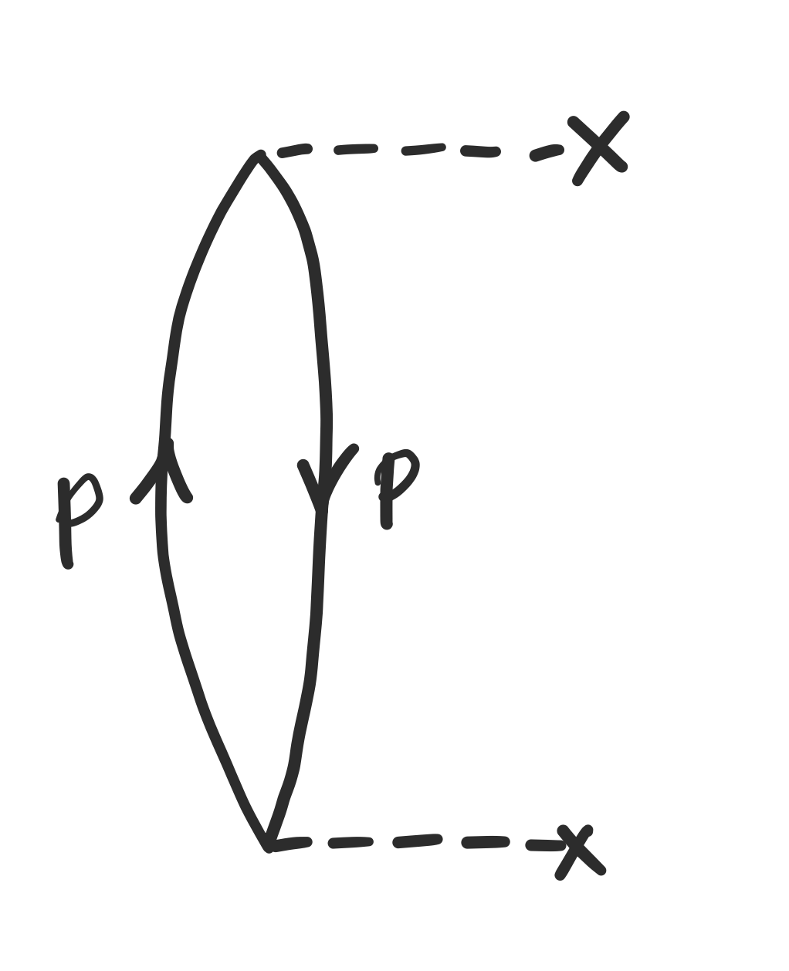
Kohn–Luttinger conundrum
Kohn and Luttinger, Phys. Rev. (1960); Hirata, submitted (2020)
?
Tends to infinity at degenerate HOMO
Tends to zero
Anomalous diagram

Slide 41
Luttinger–Ward resolution
Luttinger and Ward, Phys. Rev. (1960); Hirata, submitted (2020)
?
Tends to
each other

Slide 42
Luttinger–Ward: first order
Luttinger and Ward, Phys. Rev. (1960); Hirata, submitted (2020)
?
Tends to
each other

Slide 43
Luttinger–Ward is not a solution
Hirata, submitted (2020)
For degenerate ground state,
Rather
The right-hand side cannot be written in a closed expression of molecular integrals

Slide 44
Luttinger–Ward is not a solution
Hirata, submitted (2020)
?
For degenerate ground state,

